Slide 1
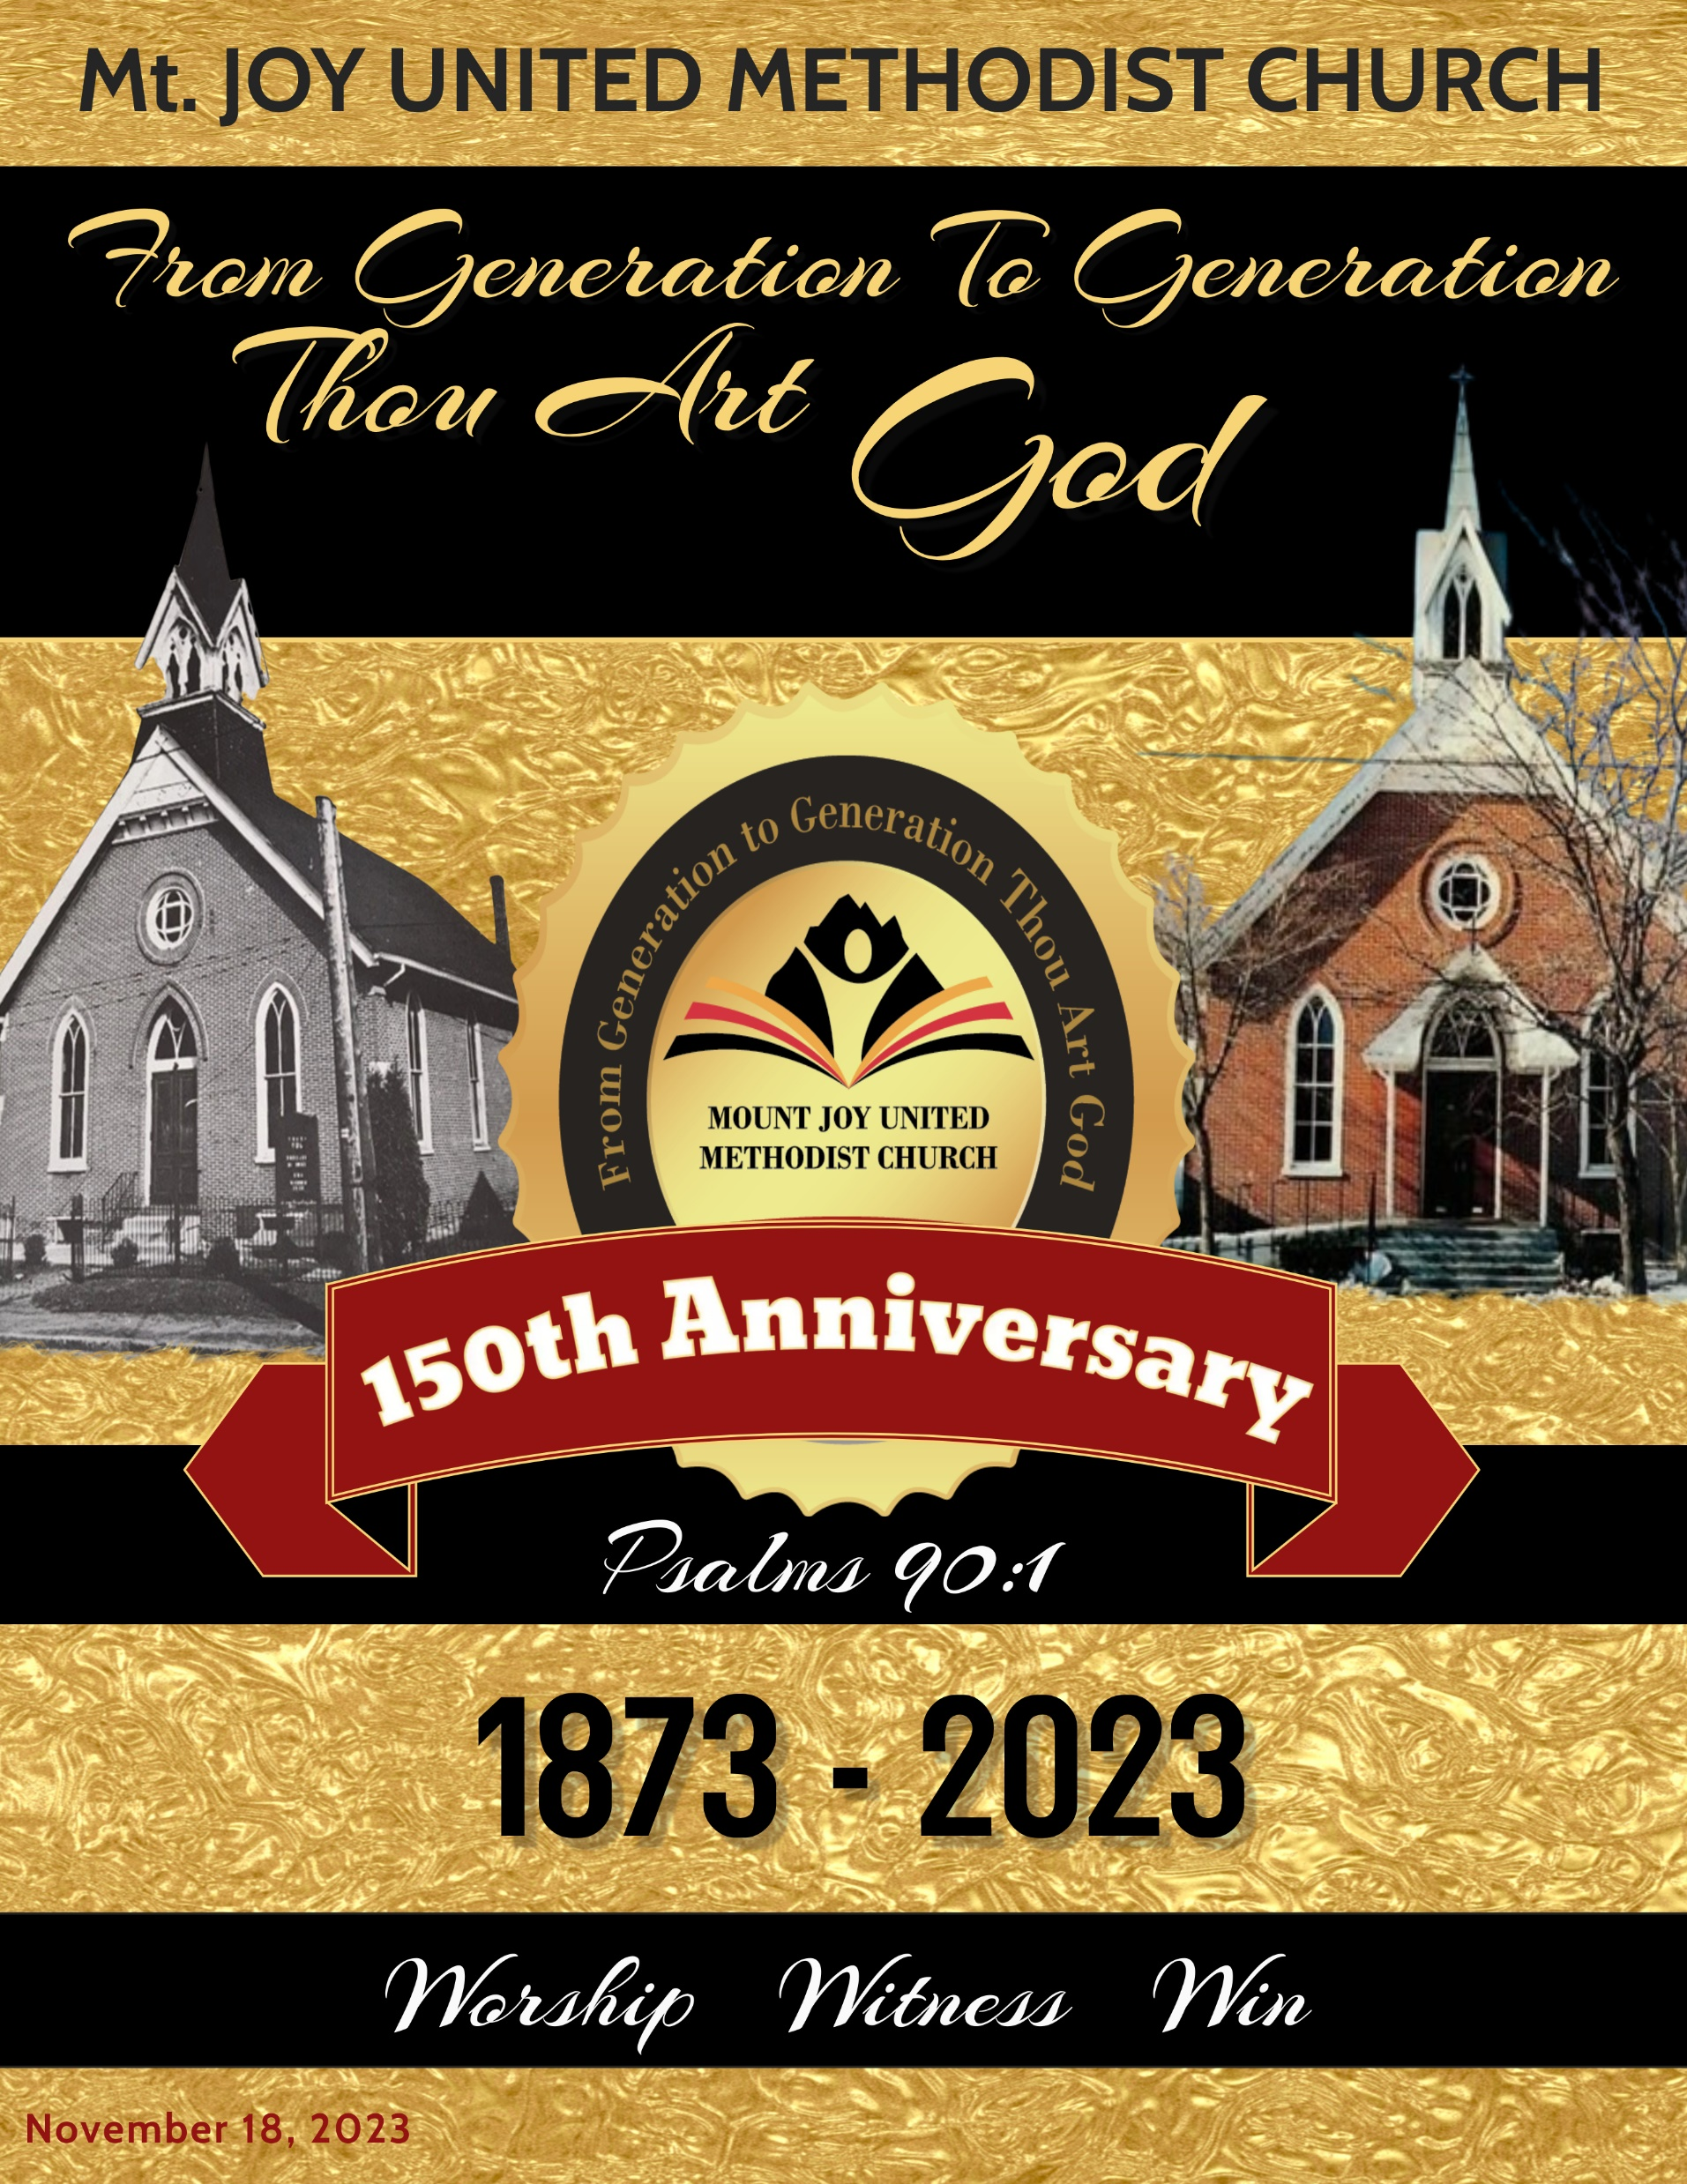
SSSSSSSSSSS
November 19, 2023
Sunday 10:00 a.m.
Mt. Joy U.M. Church
451 Townsend Street
Wilmington, DE 19801
WORSHIP
SERVICE
Rev. Provey Powell, Jr., Sr. Pastor

Slide 2
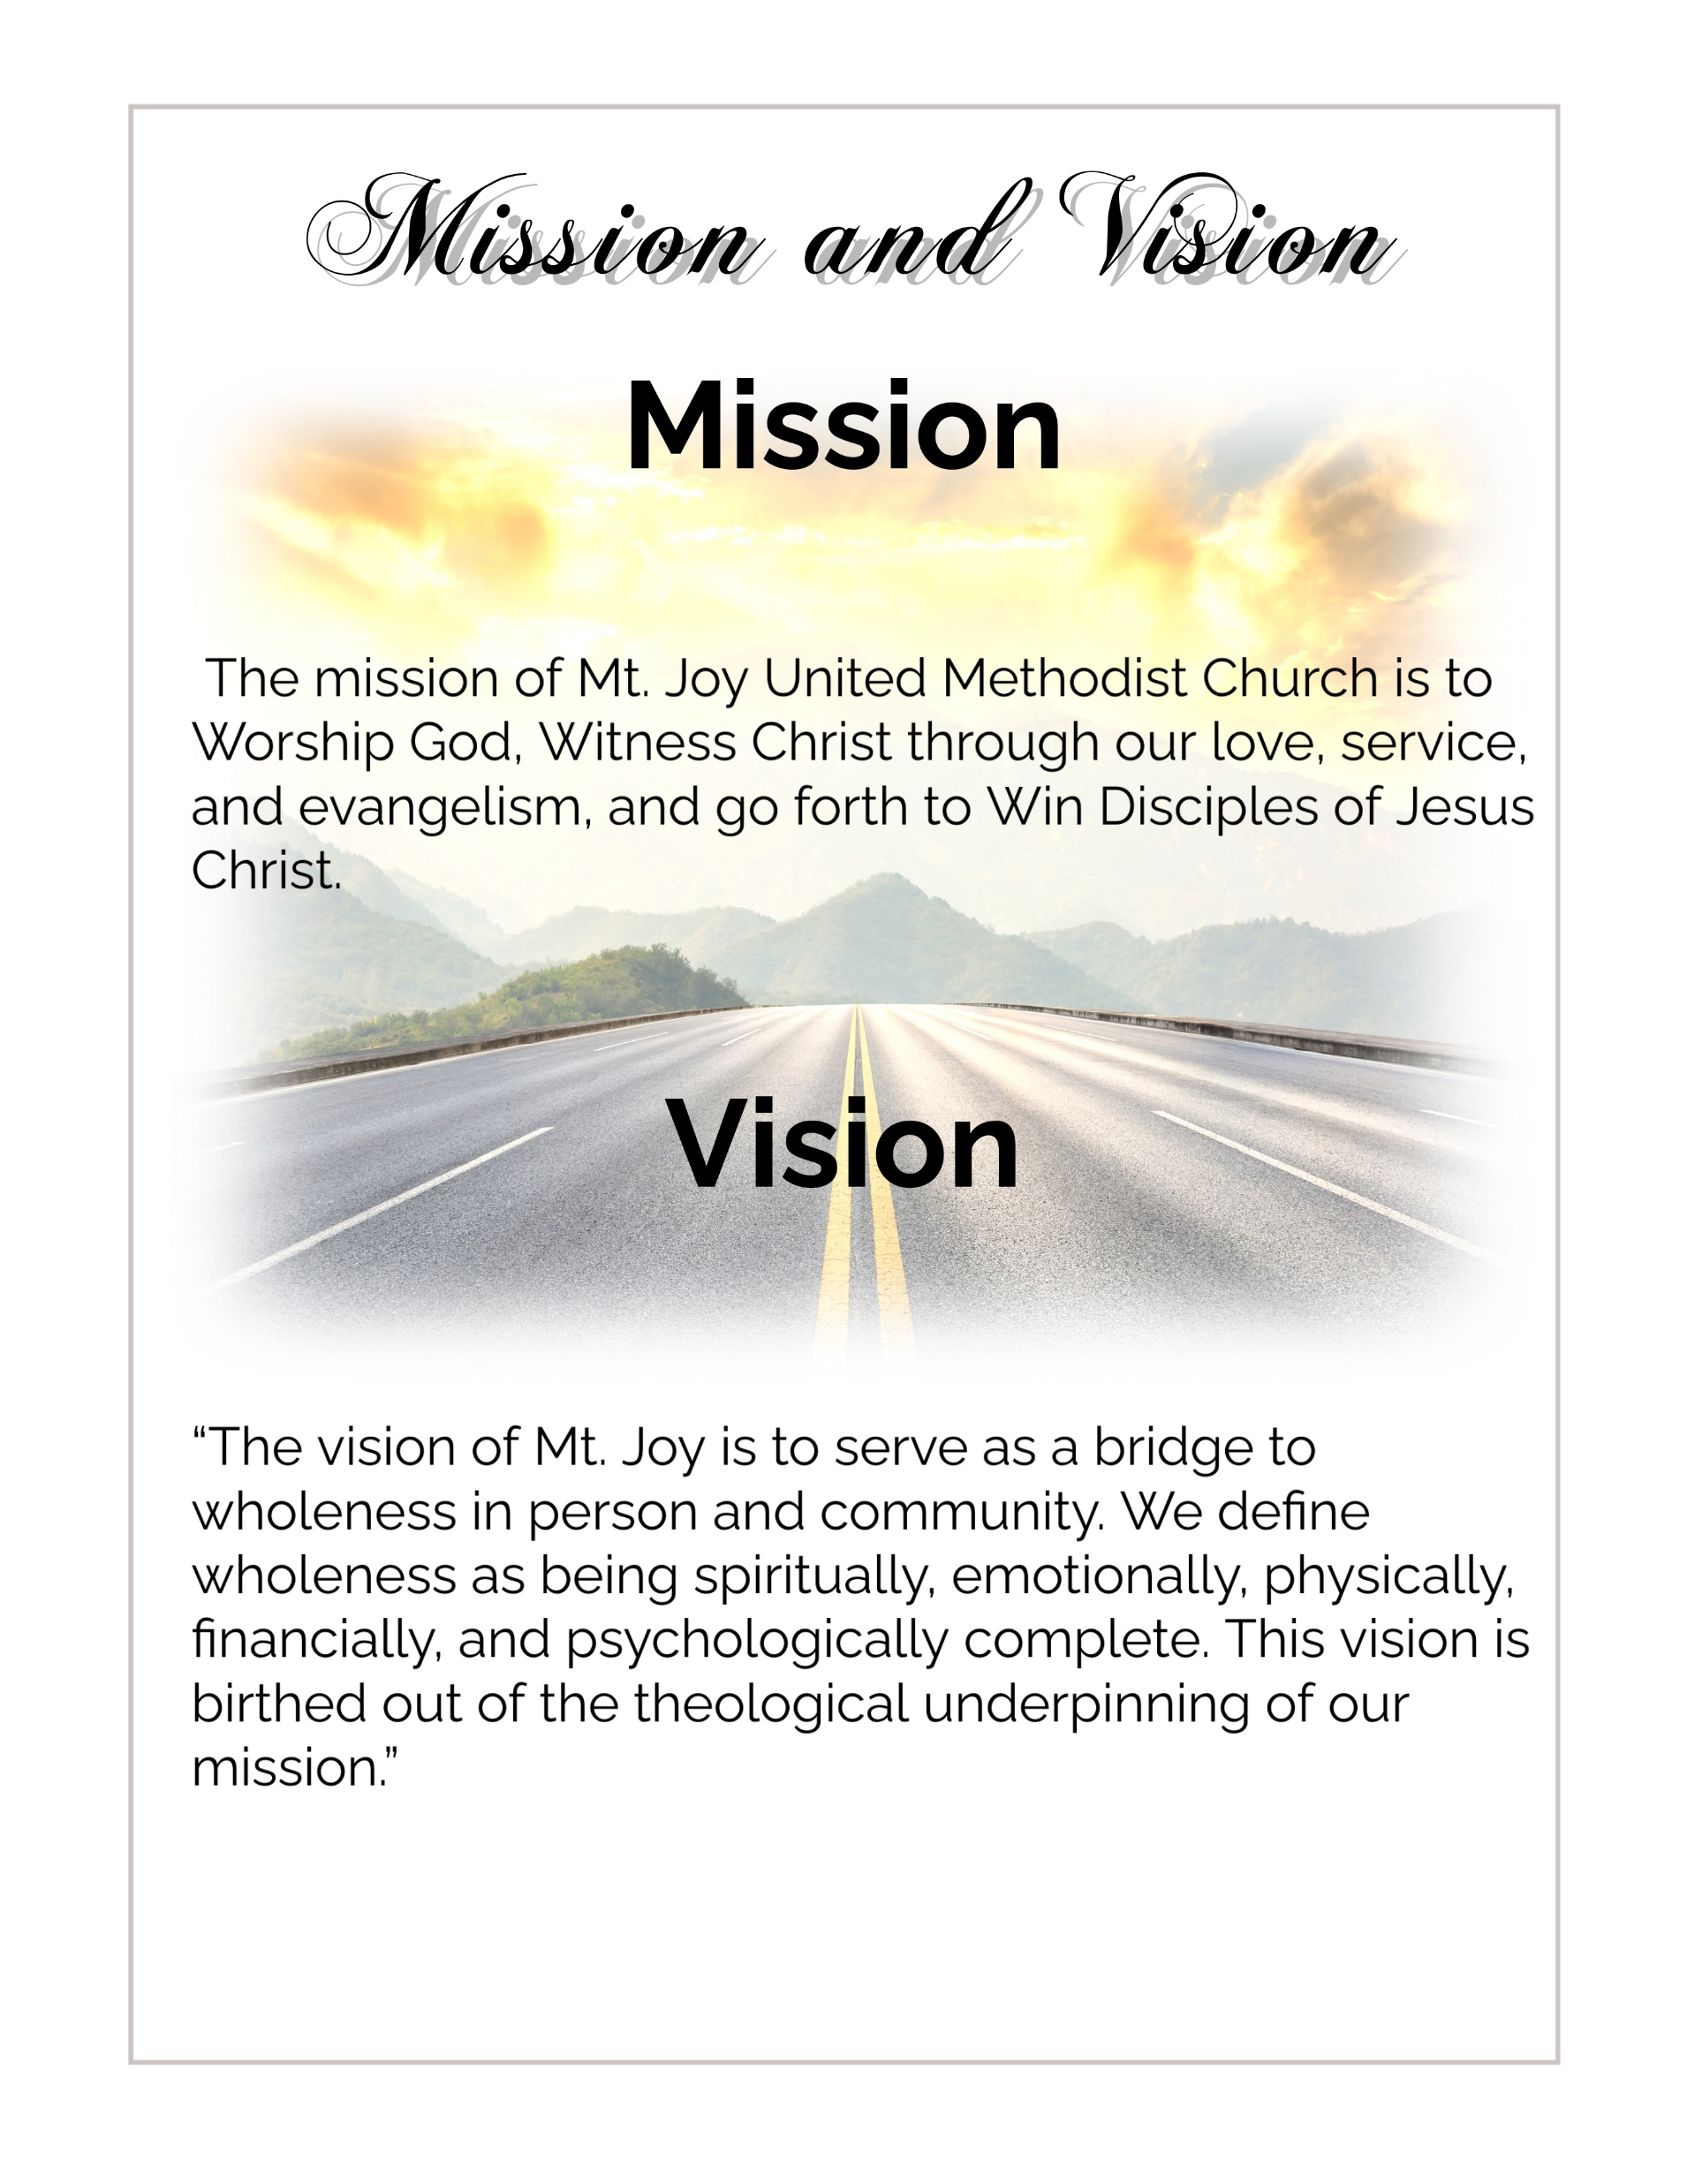
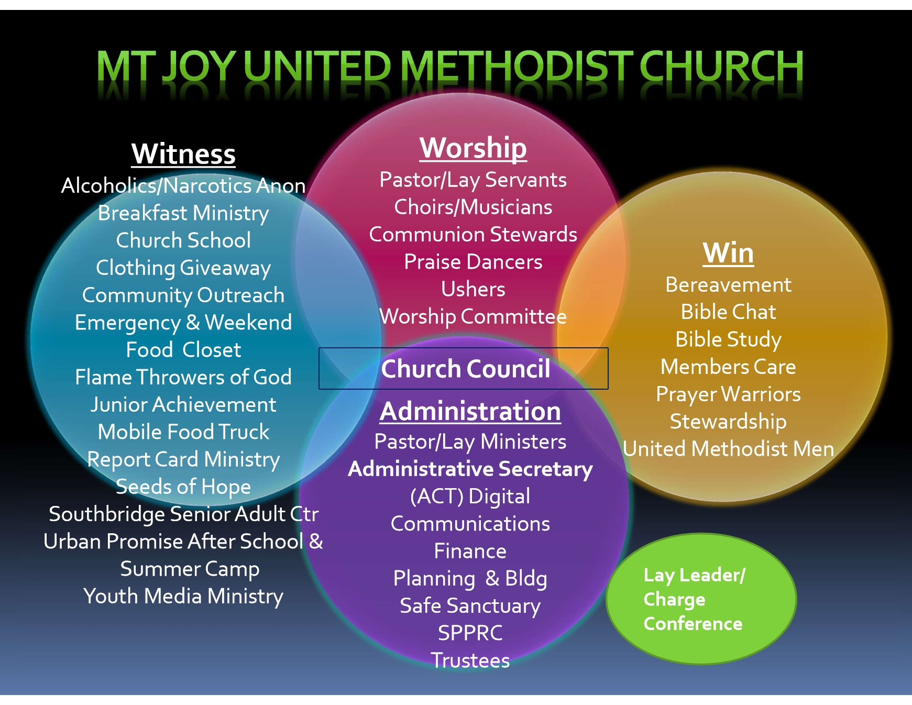
Ministry Structure
To Serve As Bridge to Wholeness in person and community.

Slide 3
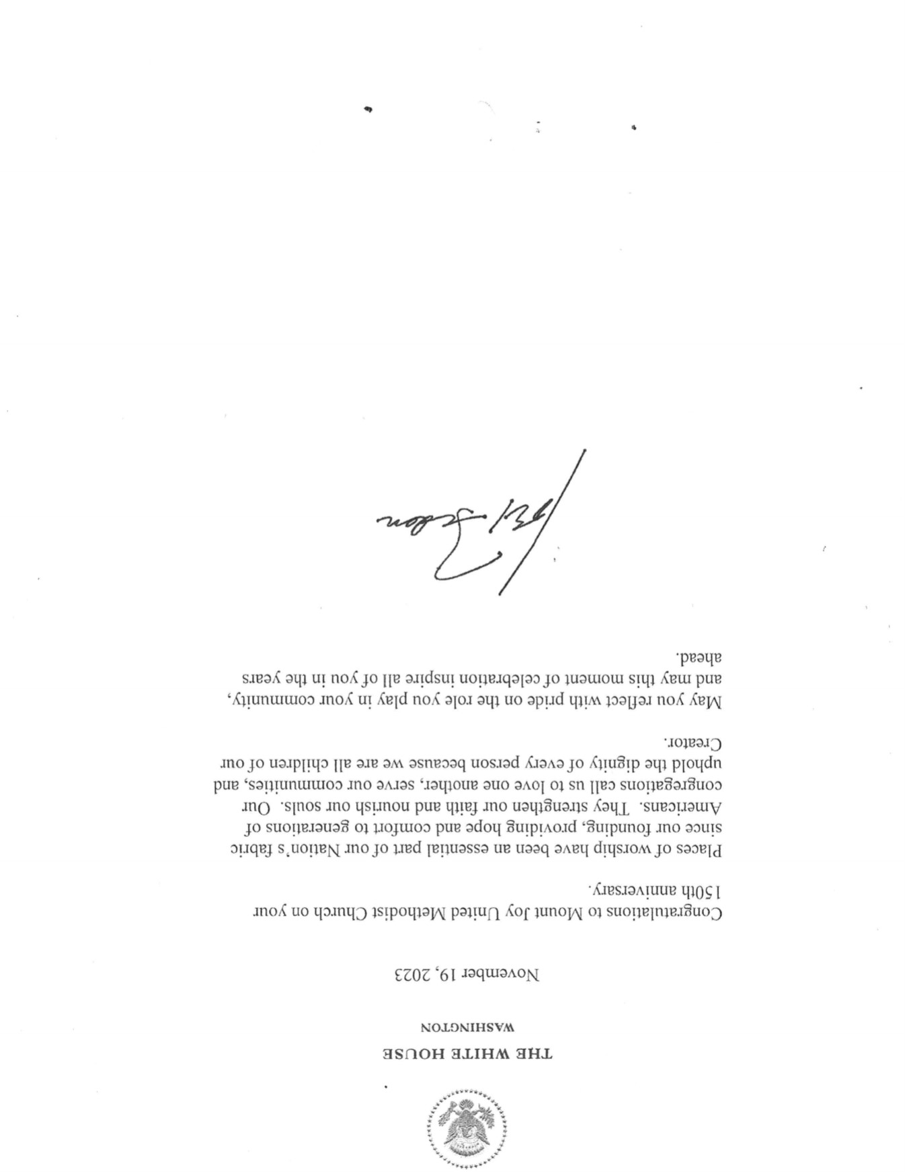
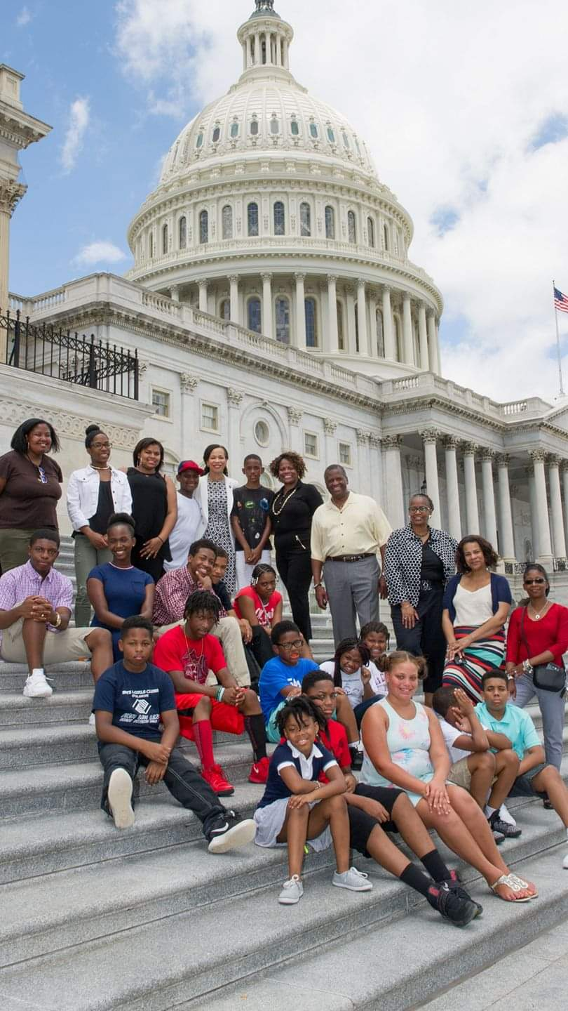

Slide 4
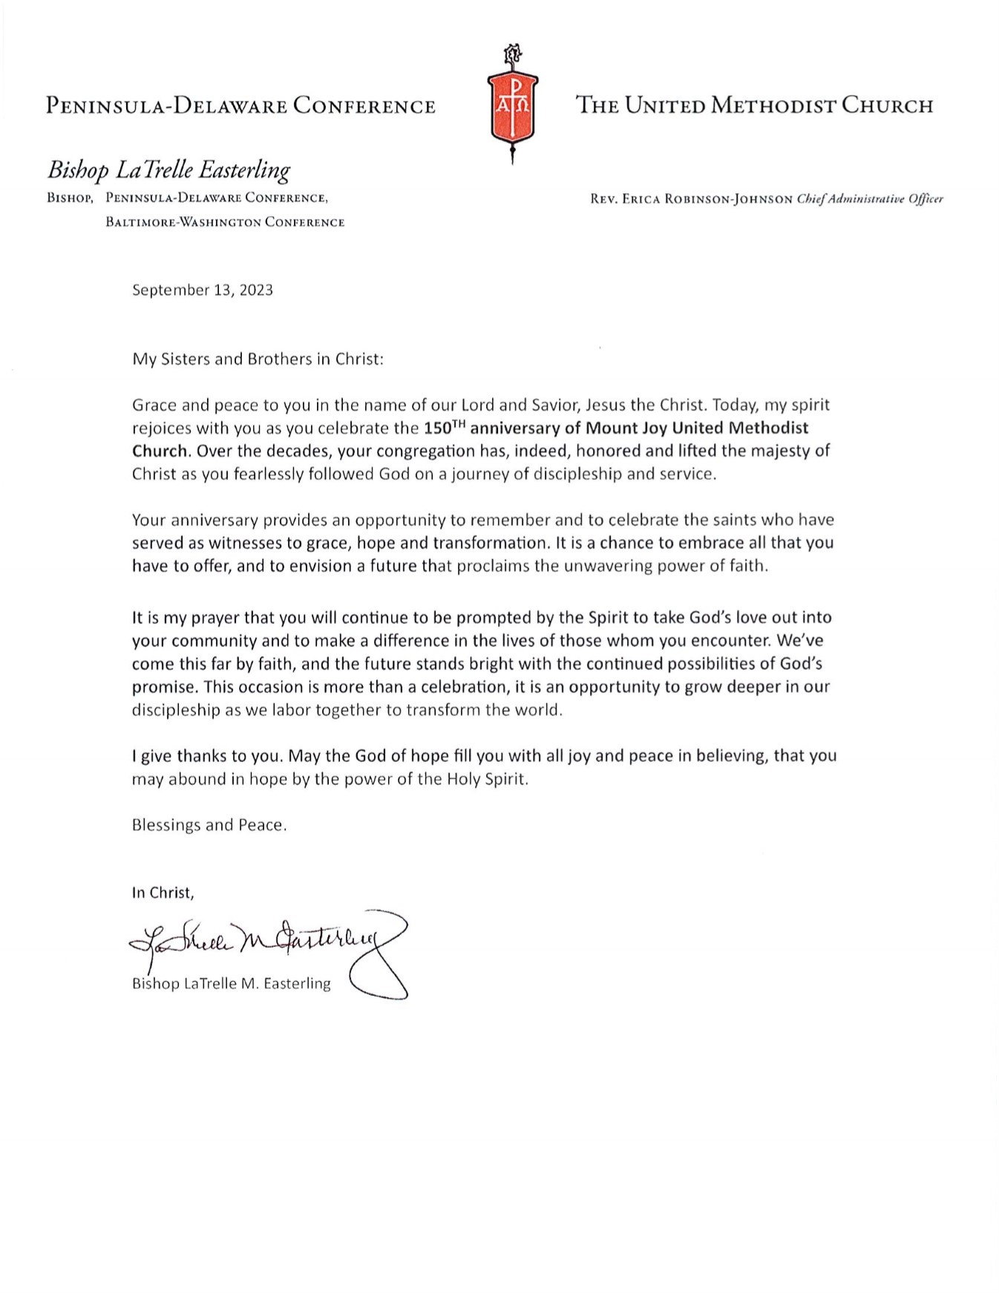
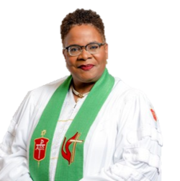

Slide 5
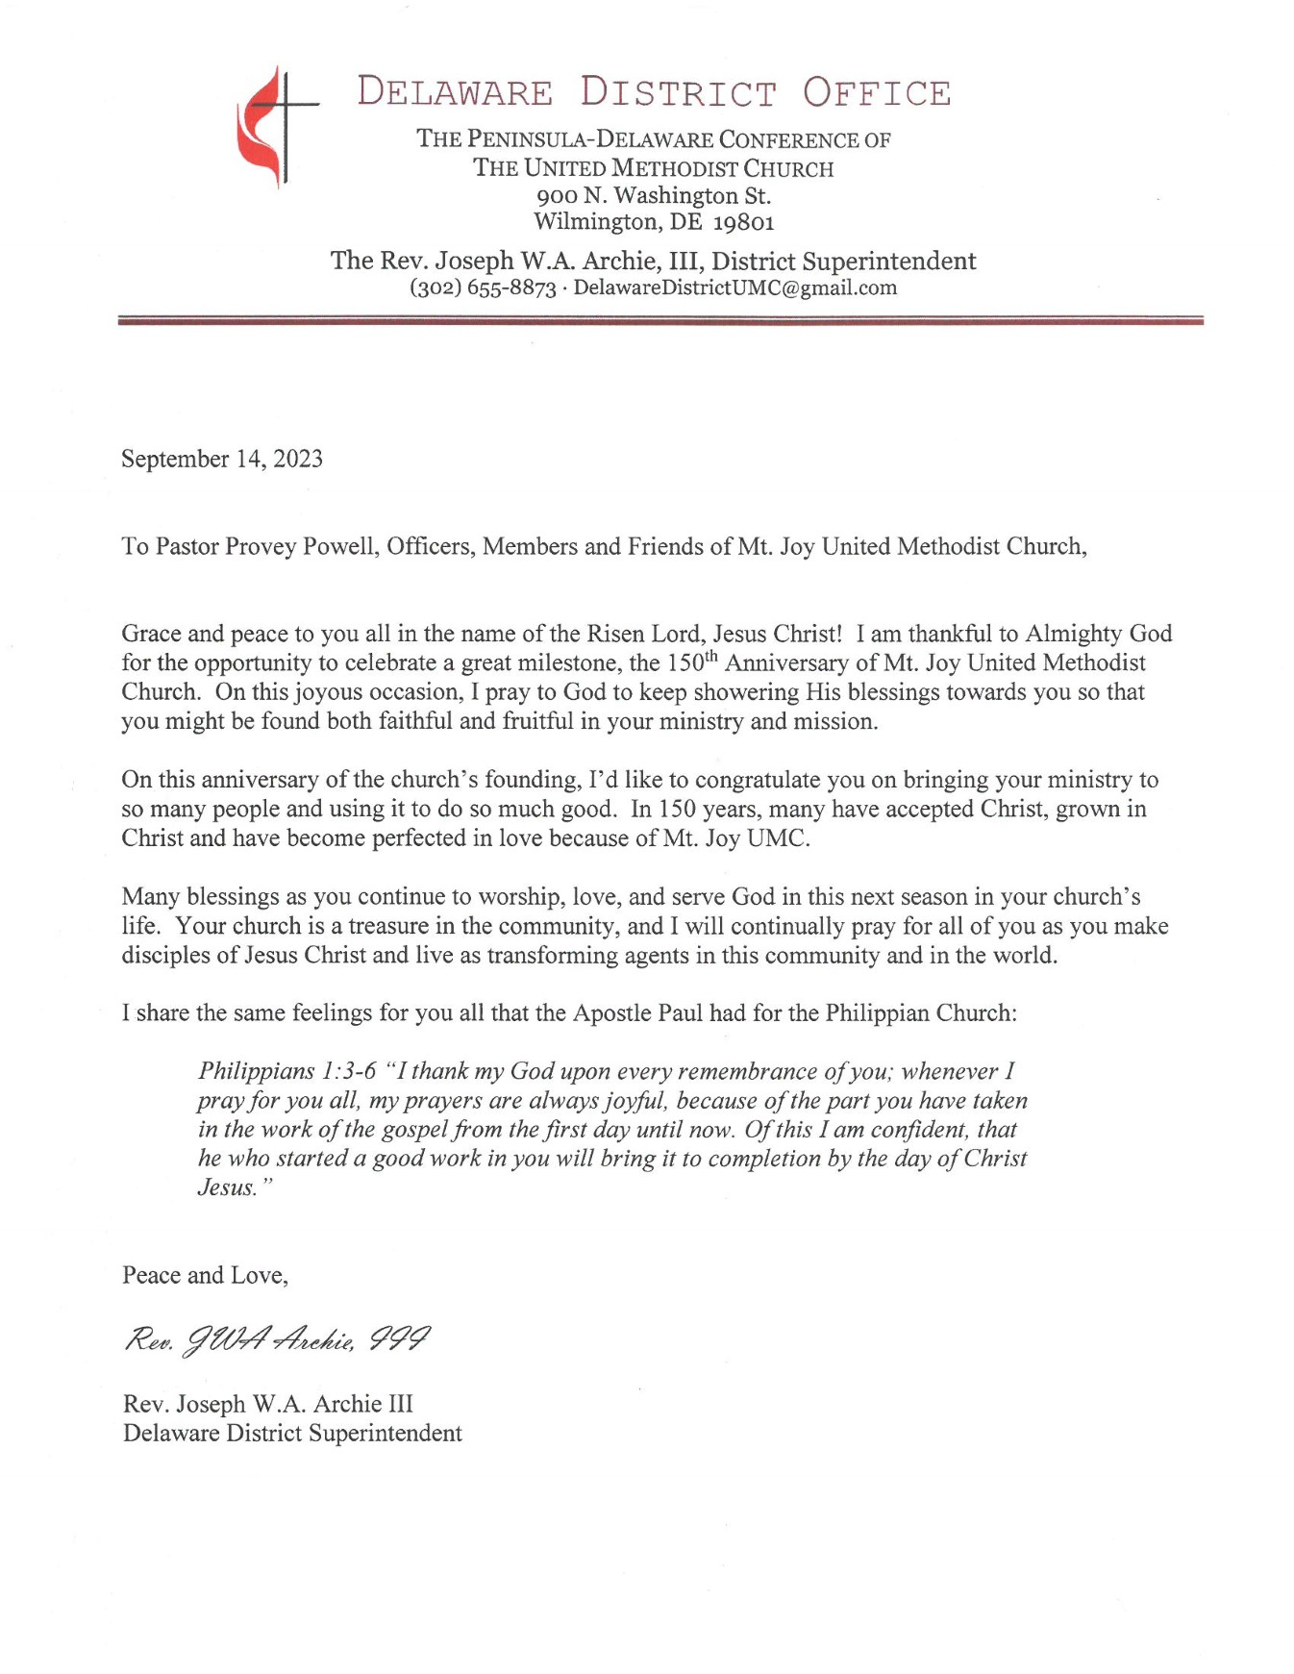
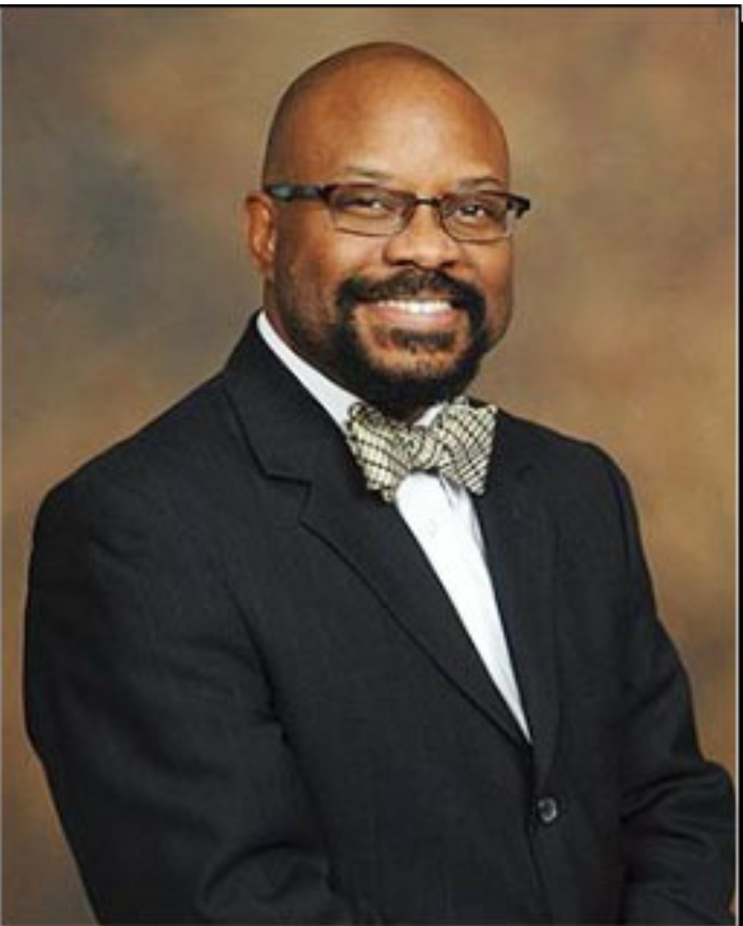

Slide 6
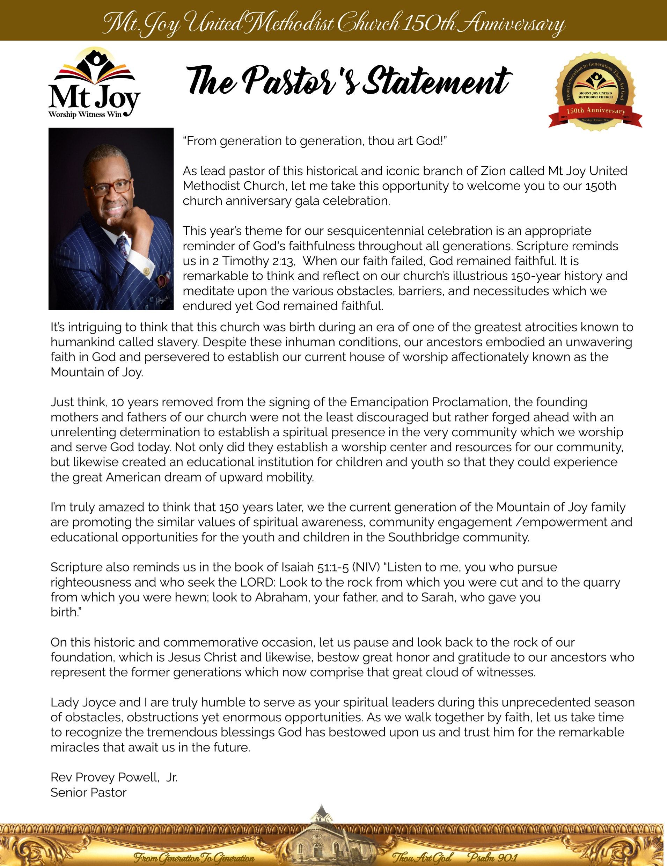
Rev. Provey Powell, Jr.
Sr. Pastor

Slide 7
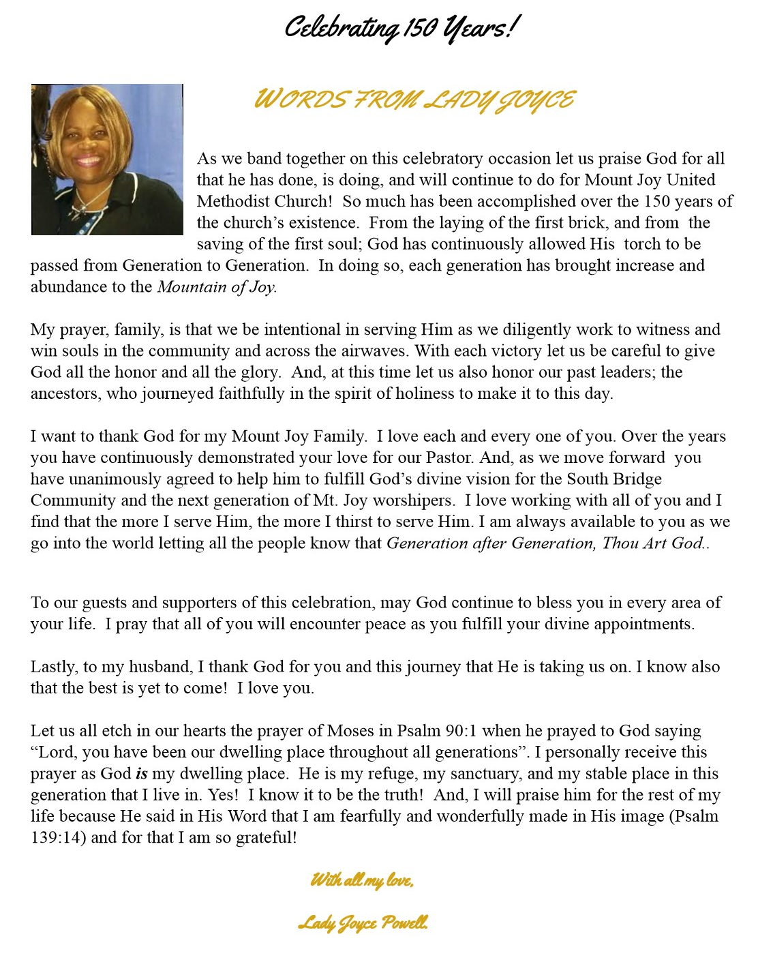
First Lady’s Statement

Slide 8
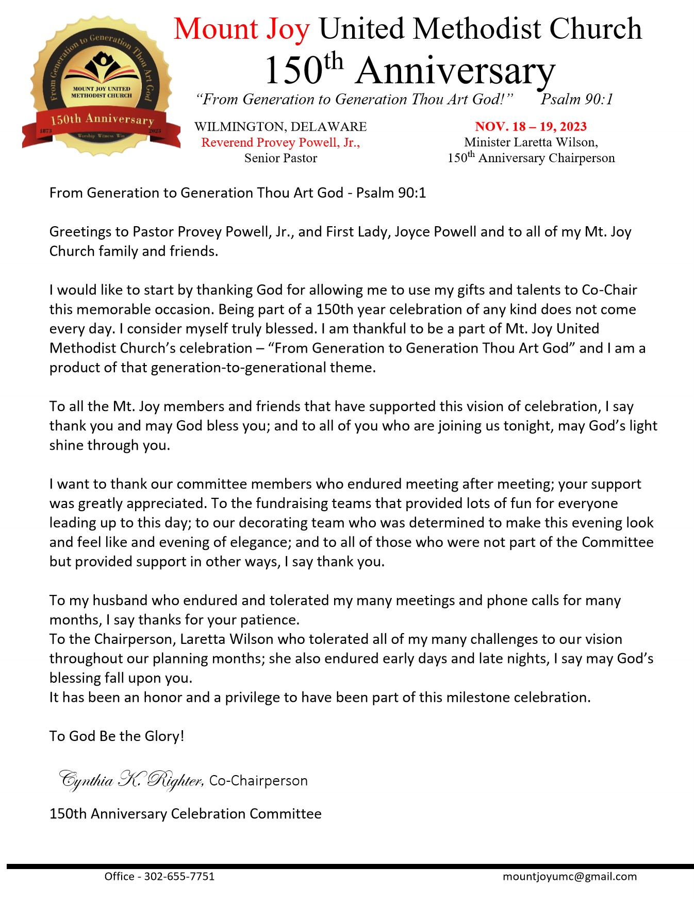
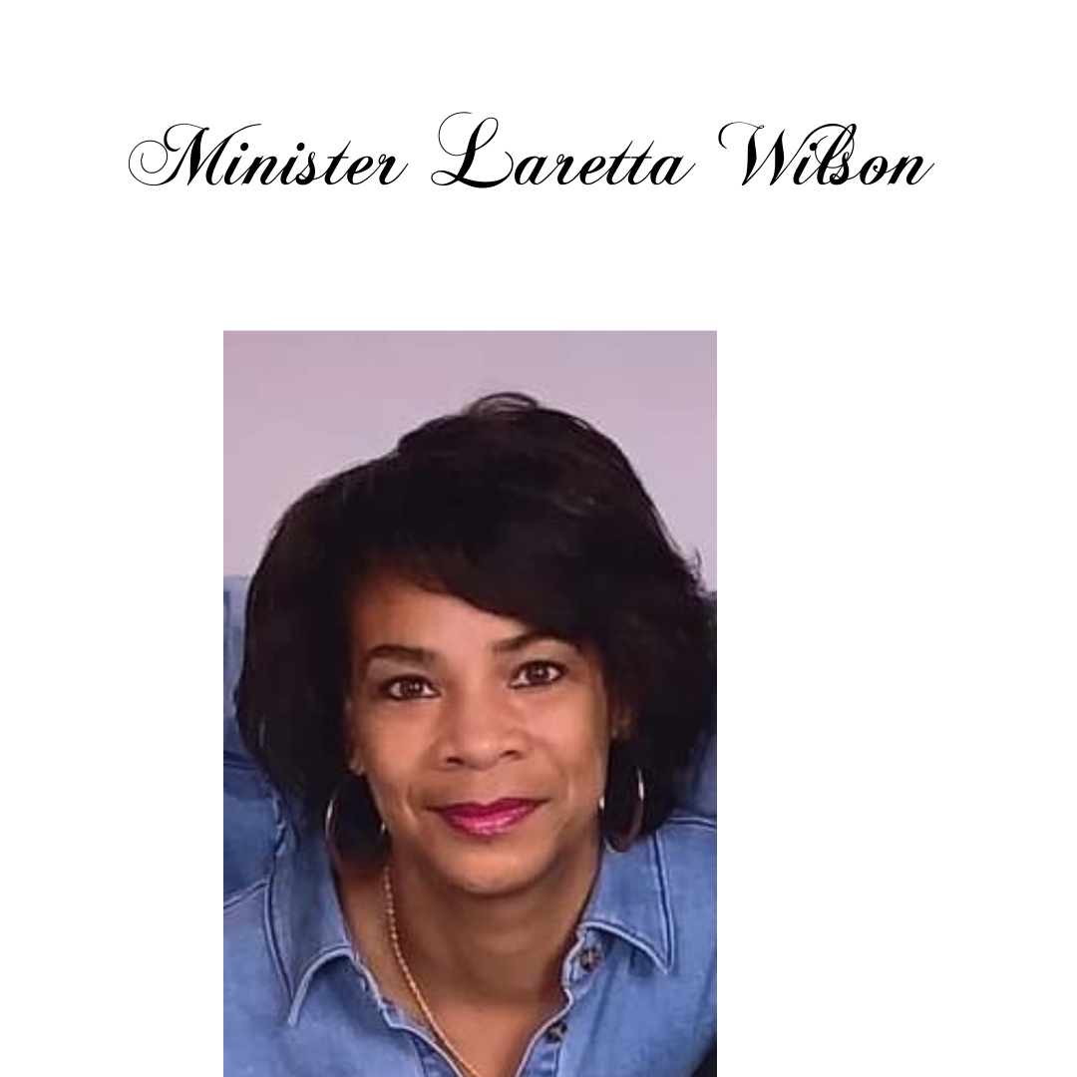
It is with great reverence to God, and my church that I have chaired Mt. Joy’s 150 th Anniversary
Celebration. It is no coincidence, but more likely Gods’ design that 50 years ago my grandmother Trafinna R. Wilson chaired the 100 th Anniversary Celebration. With my family having 7 generations attend Mt. Joy UMC I can truly attest that “From Generation to Generation Thou Art God”. Mt. Joy provided a spiritual foundation that would include my history making moment as the first female Acolyte, attending Sunday School, being a Jr. Usher, and singing on the choir beginning in the early 70’s under the leadership of Rev. Jesse and Charlotte Walker. My Great Grandfather, Howard (Snap) Coage and my grandmother Trafinna Ruth Wilson were my family’s roots in the Mt. Joy tree, and we are still here.
Serving Mt. Joy in its many ministries for more than 52 years has been an absolute honor. However, the Music Ministry brings me the most joy. I love to sing especially “Thank You Lord (for all you’ve done for me)”. But never would I have imagined being called into Lay Ministry. My favorite scripture is Jeremiah 29:11 For I know the plans I have for you, “declares the Lord”. I am humbled that God would use the life and testimony of a little girl from Southbridge to bear witness to the providence of God to others. Words could never describe the love and gratitude I will always feel for my grandmother, my dad George Wilson, and aunt Aretta Harrison who kept our family and its values intact. The spiritual leadership of Rev. Derrick Porter and Pastor Provey Powell Jr. influenced a closer introspection that eventually invoked my submission to the will of God. I am sincerely grateful to and love both you and Charlotte Walker.
I am also grateful to you, my Mt. Joy family, friends, and constituents. For you to be here with us
celebrating 150 years of service to the Southbridge Community and surrounding areas is a true
testament to God’s favor on our church. To my Co-Chair Cynthia Righter your commitment to making this Gala a success was unwavering and I thank you for your patience with us all and am so glad we were able to do it together again. Kudos to all the Anniversary Committee for your time and talents in whatever capacity you contributed to this historical event. You are loved and appreciated. I would like to give a special shout out to Loraine Watson, our honorary member who continued to encourage Cynthia and me as she worked tirelessly to create the beautiful Souvenir Journal you are viewing.
Proverbs 29:18 tells us “Without a vision the people will perish”. I have faith that Mt. Joy’s Vision “To Be a Bridge to Wholeness” will manifest itself into a full campus at Townsend, B and Buttonwood Streets to continue its Mission to Worship, Witness and Win disciples for Christ for the transformation of the world.
Mt. Joy pray without ceasing and let our faith be the driving force to get it done.
God Bless You All!
Min. Laretta E. Wilson, Chairperson

Slide 9
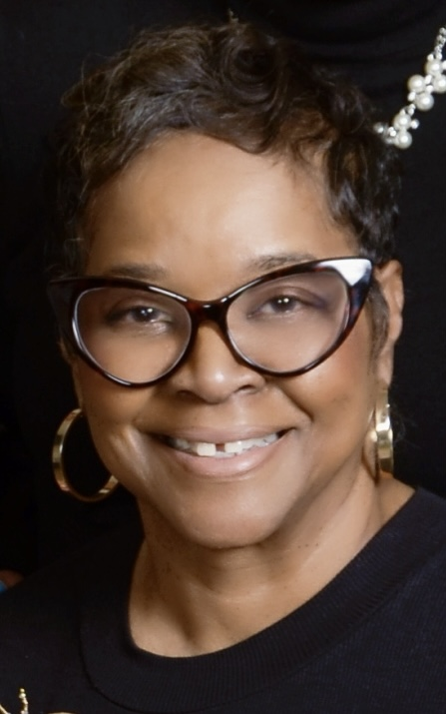
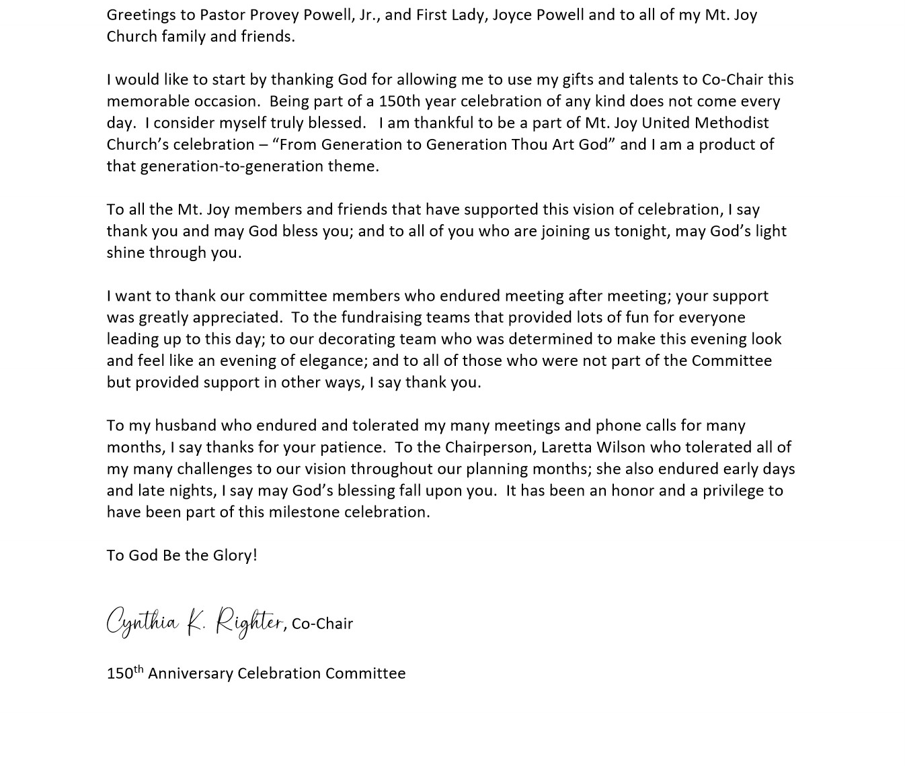

Slide 10
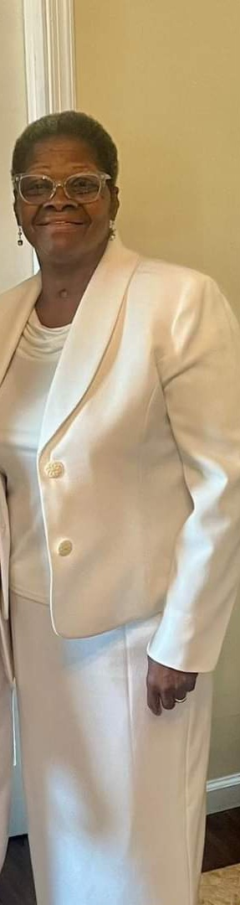
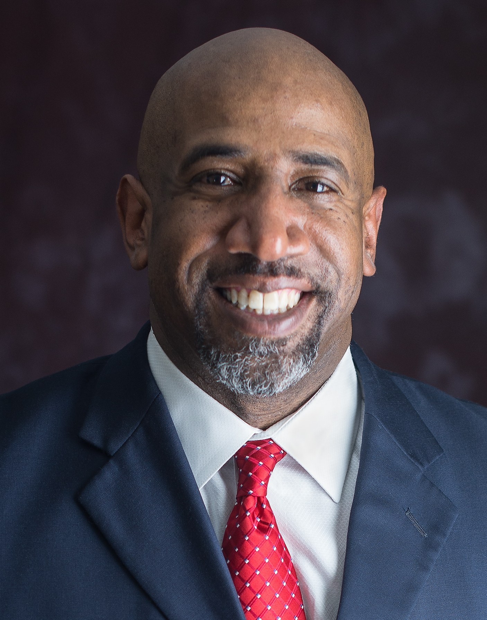
WORSHIP LEADER
Min. Robin Henry
New Pentecostal United
Holy Church Of America
Minister Robin Henry, a Solider on the battlefield for the lord, Married, Mother, and a Woman of God. I have been a member of New Pentecostal Church for 35 plus years and I love to praise the lord.
Guest Pastor
Rev. Dr. Joseph W. Daniels, Jr.
The Emory Fellowship 6100 Georgia Avenue NW, Washington, DC 20011
dd
c (240)472-3182; o (202)723-3130
https://www.emoryfellowship.org/

Slide 11

Order of Worship
……………………………… Praise & Worship …….………………………
Processional
Introduction of MC…………………..………….……… Antoinette Houston, Riverside Chapel Nashville, Tn
Mistress of Ceremony ………………………………………………… Min. Robin Henry
New Pentecostal United Holy
*Call To Worship…………………………………………………………… Min. Robin Henry
*Hymn of Praise “We’ve Come This Far By Faith”
Welcome …………………………………………………………………….. Maureta Collins
Response ……………………………………………………………………. Susie Wilson, New Destiny Fellowship
Prayer ……………………………………………………………………….. Joel Orr, Urban Promise
Prayer Response …………………………………………………….... Mt. Joy Combined Choir
Scripture ……………………………………………………………………. Cherae Latney, Glorious Church
Liturgical Dance ………………………………………………………... Seeds of Hope
Church History …………………………………………………………… Marlene Wright
Selection……………………………………………………………………. Mt. Joy Combined Choir
Recognition of Pastors and Officials…………………………….. Min. Robin Henry
*Offering/Offertory……………………………………………………… Nyrie Watson - Alexander J. Fawra, Jr.
Introduction of Preacher………………………………………….. Rev. Provey Powell, Jr., Sr. Pastor
Selection(s) ……………………………………………………………… Mt. Joy Combined Choir
Sermon……………………………………………………………..……… Rev. Dr. Joseph W. Daniels, Jr.
Emory United Methodist Church
Presentations………………………………..…..…………….……… Beverly Evans and Betty Anderson
Closing Remarks……………………………………………….………. Cynthia Righter, Vice Chairperson
Laretta Wilson, Chairperson
Rev. Provey Powell, Jr.
Benediction…………………………………………………………….. Rev. Dr. Joseph W. Daniels, Jr.

Slide 12
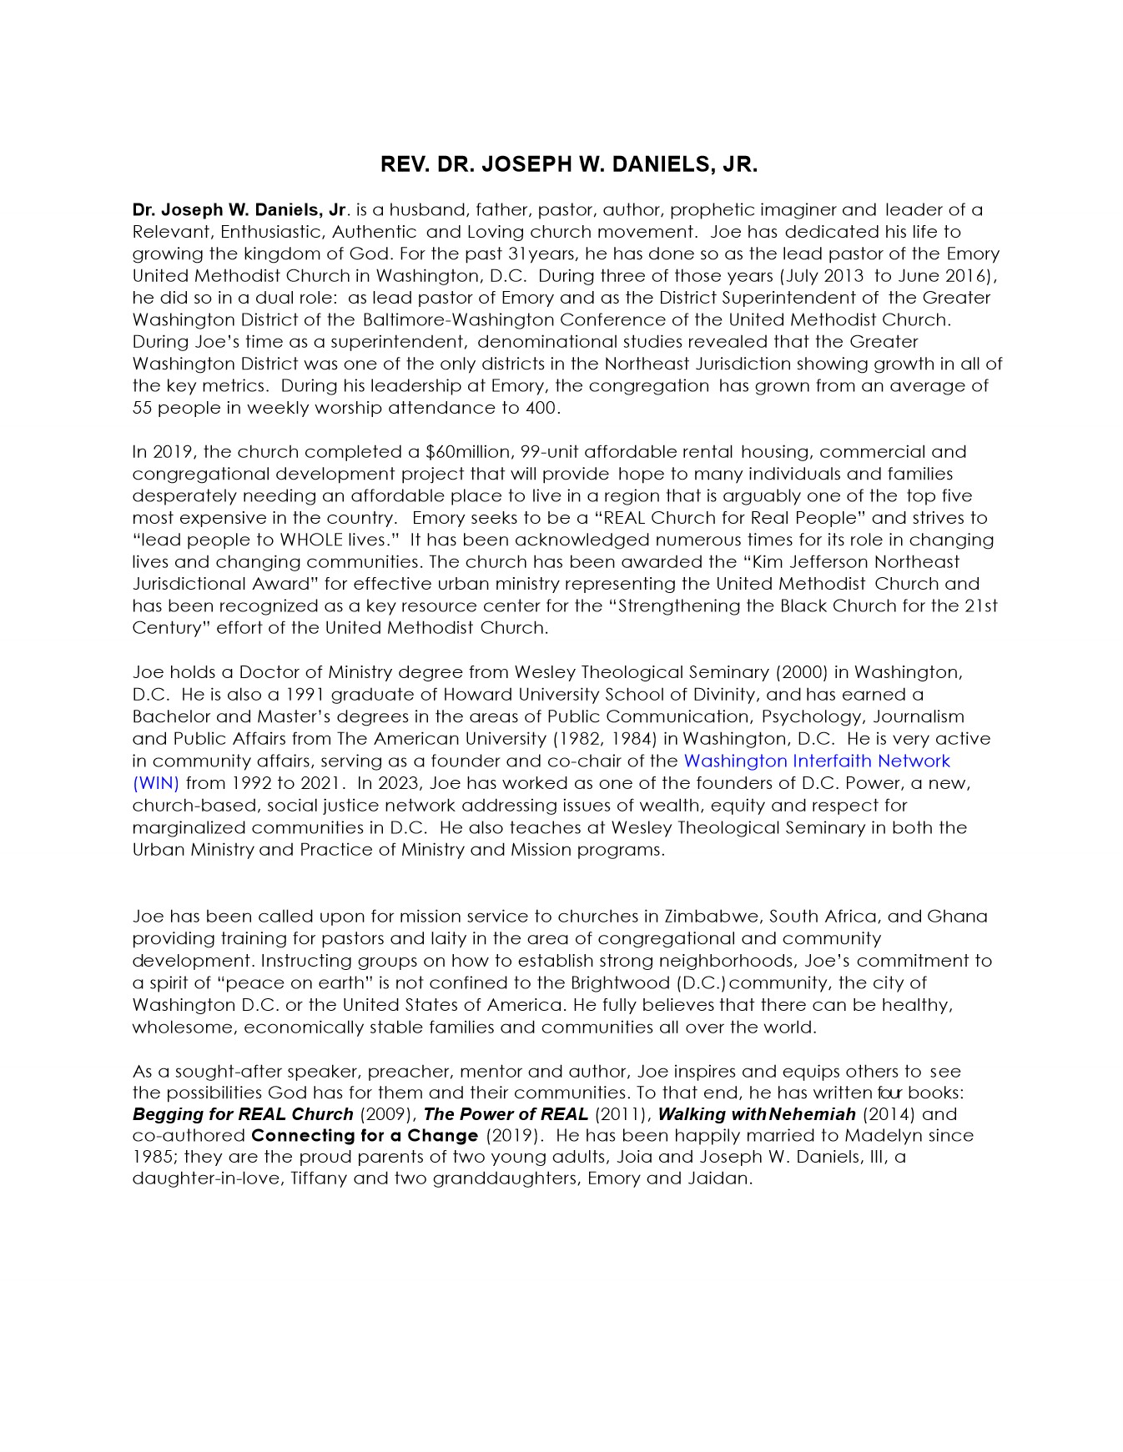
Guest Pastor

Slide 13
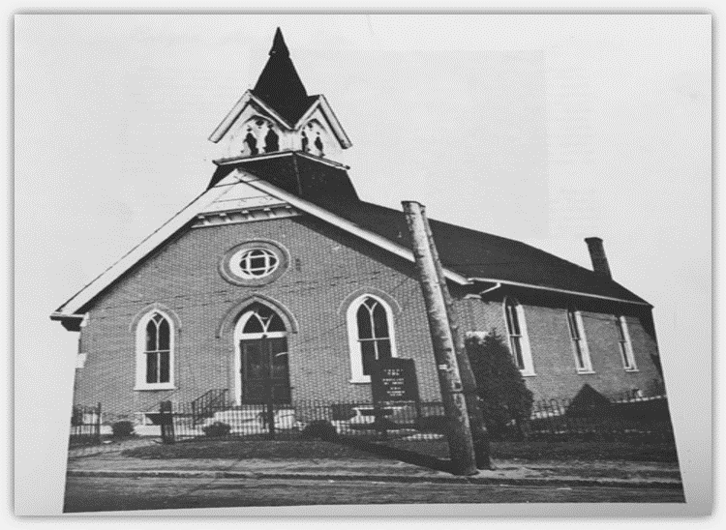
Pastors of MT JOY U.M. Church
LAYMEN OF 1873
Mr. & Mrs. Francis Byrd Mr. Soloman T. Bantum Mr. Charles H. Smith
1873 Reverend Hooper Jolly Pastor Ezion Church 1875 Reverend Soloman Cooper Pastor Ezion Church Reverend Lewis Y. Cox Reverend Perry Walker 1876 Reverend William Holland 1877-1883 Reverend I. H. White Reverend Harrison Webb Reverend J. J. Campbell 1884 Reverend F. Butler Reverend Hezikiah Grinnage 1885 Reverend Andrew J. Wallace 1887 Reverend Charles Tinley Reverend William Hilton Reverend William J. Hudson 1888 Reverend J.A. Richardson 1889 Reverend Harvey W. Ewing Reverend J. R. Waters Reverend J.A. Richardson | 1890-1910 - HISTORY NOT AVAILABLE SEE BARRETTE CHAPEL LIBRARY DOVER , DELAWARE 1911 Reverend D. H. Harris 1914 Reverend W. E. Waters 1926 Reverend J. W. Jewett 1927 Reverend Sidney Emptage 1932 Reverend L. H. McArthur 1935 Reverend R. B. Thompson 1940 Reverend J. H. Russum 1945 Reverend G. E. Geddis 1948 Reverend J. W. Watson 1954 Reverend W. H. Johns 1955 Reverend R. C. Hughes | 1960 Reverend Augustus Chancy 1970 Reverend Richard Hicks 1971 Reverend Jesse Henry Walker 1981 Reverend Donald Hamilton 1985 Reverend Dr. Janet Harmon 1992 Reverend George Commodore 1993 Reverend Lorenzo Murdaugh 1997 Reverend Derrick Porter 2010 Reverend Dr. James T. Seymour 2011 Reverend H. Ward Greer 2014 Reverend. Dr. James T. Seymour 2015 - Present Reverend Provey Powell, Jr.

Slide 14
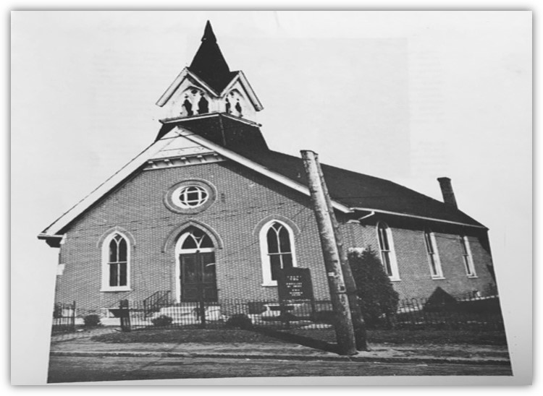
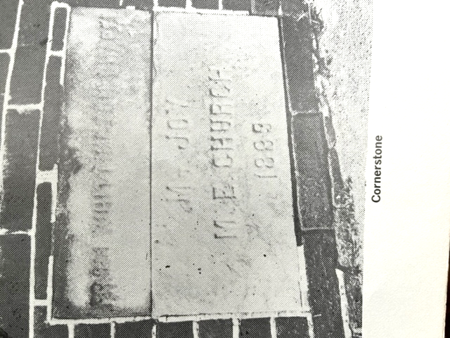
Some Important Milestones
Southbridge area known as “Turkey Town”
1873 – Chapel erected on “A” Street; Dedicated and named “Whittington Methodist Episcopal Church in honor of Rev. Joseph Whittington, a former pastor of Ezion Methodist Church
1875 – Chapel burned to ground
April 29, 1889 - Church foundation completed
June 12, 1889 Corner Stone was laid
1889 - Named changed to Mt. Joy and identified as the “Singing Church”
1968 – Parsonage (625 S. Heald St.) was purchased
1970 Buttonwood Church merge with Mt. Joy – became Mt. Joy Buttonwood Charge
December 3, 1972 – Groundbreaking of the Mt. Joy Multipurpose Community Center
April 15, 1972 – Multipurpose Center renamed to the “Sonya Maria Wright Fellowship Hall”
1974- Mt. Joy Church was renovated (Community and government partnership)
1987 – Senior Program started
1991 – Mortgage Burning Service of Addition -1978 (5-19-1991)
1997 – Church mission updated to “Worship- Witness – Win”
2000 – Building Committee Established
2015 – Audio –Communication – Technology Ministry developed
2019 – Updated Vision and Mission Statement
2020 – Revitalization of Building Committee
2022 – Wholeness Campus Project Implemented
2023 – Mt. Joy CDC (501 c 3) created

Slide 15
Church History
Abridged from the 150th Anniversary Souvenir Journal
In 1789 Old Asbury Methodist Episcopal church was organized after both blacks and whites began to congregate under a tree for Sunday Worship at 8th & King streets in Wilmington. As a result, people from MD Eastern Shore and lower DE began to migrate to the area known as Turkeytown.1873 there was an initiative to begin Sunday School by the Byrd, Bantam & Smith families in a house on Buttonwood St.
What started with 5 children becoming too many to hold in one house. This news was brought to the attention of Rev. Hooper Jolley the pastor of Ezion M.E. Church. He led an effort to purchase a lot on the corner of “A” Street. In spite of several difficulties, a chapel was erected and dedicated in August 1873. It was named Whittington Methodist Episcopal Church in honor of Rev. Joseph Whittington, a former pastor of Ezion Methodist Church. The chapel was burned to the ground in February 1875.
1875 Rev. Soloman Cooper led the building of a new chapel on the old lot. In the summer of that year this new chapel was dedicated by Rev. Lewis Y. Cox assisted by Rev. Perry Walker. In this new chapel, the Public School of South Wilmington was organized under the leadership of Brother Girard Rollins, a member of Whittington Chapel.
1877 Rev. I. H. White was the first regularly appointed pastor. From 1879 -1872 there were several pastors who served Whittington Chapel. On July 17, 1882, the Ezion trustees who had handled the business until this time elected and turned the business over to the Chapel’s trustees. In 1883, a lot, 30 x 100 feet, was bought on the east side of Townsend Street, between A and B Streets. 1884 Rev. F. Butler was appointed pastor Rev. Andrew J. Wallace became pastor in 1885 and Rev. Charles A. Tinley in 1887.
1888 Rev. J. A. Richardson was appointed. He advised the congregation to exchange the east side lot for the present location, one 40x100 feet on the west side of Townsend St. The deal cost $600.00. A brick house, next door, was bought for $700.00, which became the parsonage. Rev. Richardson was re-appointed to Whittington in 1889 and was changed back to an individual station. As an independent Church, the pastor and congregation began building a brick church on the lot at a cost of $6,000.00.
Brother Leon Collins broke ground on April 29, 1889, the foundation was completed by June 12, 1889 and the cornerstone was laid Sunday, June 23, 1889 by Rev. Harvey W. Ewing, assisted by Rev. J. R. Waters and Rev. J. A. Richardson.

Slide 16
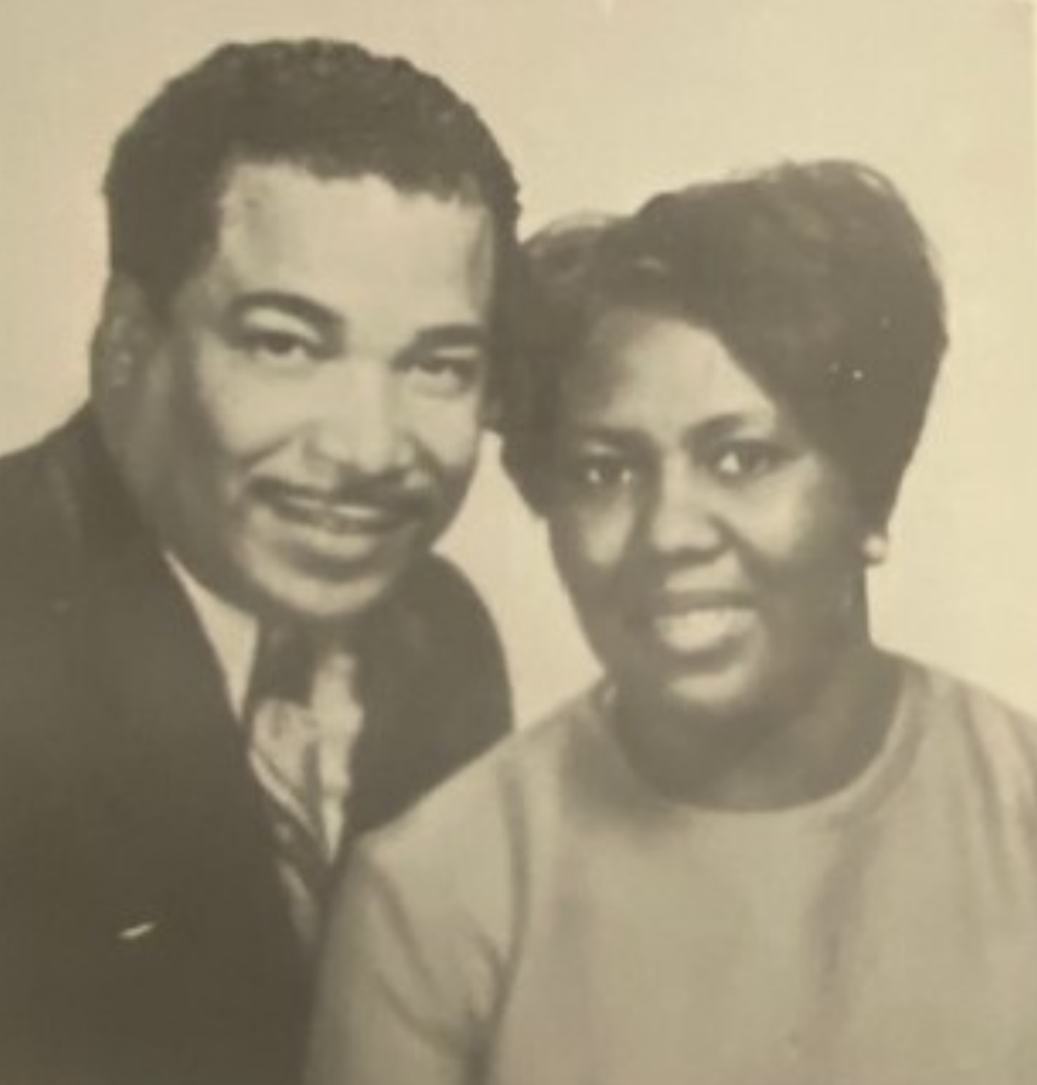
Church History
Abridged from the 150th Anniversary Souvenir Journal
The joy that filled the hearts of the people that day moved them to change the name of the Chapel to Mount Joy. Since that time Mount Joy has been known as the “Singing Church.” When Whittington became Mt. Joy, the membership was 85 and the Sunday School membership stood at 145.
From 1890 until 1960 There were quite a few preachers who were responsible for leading the church, improving the building and parsonage, leading the choirs and developing ministries.
1960 Rev. Augustus Chancy was appointed to Mt. Joy remained here until 1970 when he retired. During Rev. Chancy’s pastorate, much progress and many improvements were made including the addition of many, many new members; major repairs to the parsonage; addition of the Communion rail; conversion of organ; remodeled ceiling and increased financial reports year after year.
At the 1970 session of the Peninsula Annual Conference, Mt. Joy was again put on a circuit with the Buttonwood United Methodist Church. Rev. Richard Hicks was assigned to these Churches. Under Rev. Hicks’ leadership a Breakfast Program was started with the help of the Methodist 5 Action Program. Rev. Hicks was most instrumental in helping to introduce Rev. Walker to the Peninsula Conference and to Mt. Joy Church.
Recent History*
1971 Rev. Jesse H. Walker was a student at the Interdenominational Theological Center, located in Atlanta, Georgia. He would be graduating later that year. While attending a Black Methodist for Church Renewal (BMCR) meeting, he met Rev. Richard Hicks. Through conversation, he learned that Rev. Hicks would be leaving Mt. Joy after the conference that year. Rev. Hicks suggested that Jesse might be interested in coming to Mt. Joy and that he would put him in contact with the Superintendent of the Wilmington District. The Rev. Howell O. Wilkins, the Superintendent, and his family, stopped in Atlanta on their way to Florida for spring break, interviewed Jesse, and the rest is history. Jesse came up in May, following his graduation from seminary, to attend the annual conference. At this time, he was an Ordained Deacon. At the annual conference the following year, he was ordained carry out that project.
Mt. Joy was a church with great spiritual assets but had seemingly become lax in the general upkeep of its physical structure. Approximately $6,000.00 was owed on the parsonage. It was a struggle just to meet regular utility bills. Mt. Joy had always, down through the years, paid its conference asking’s in full.

Slide 17
Church History
Abridged from the 150th Anniversary Souvenir Journal
The Church had no apparent credit with the local businesses and supply houses, yet it had been granted $17,000.00. This was given added influence by the presence and concern of the Mayor of Wilmington, Harry G. Haskell, who had been a friend of the Church most of his life.
The church’s office was in a row house in the back of the church. It needed repairs. An appeal was made and an organization (whose name I cannot remember) sent a sizable donation to help pay for repairs. Rev. Walker had a different vision and convinced the trustees, after much consideration, to return the donation because it had been sent for a specific purpose and we no longer planned to carry out that project. Instead, the idea of building an addition was considered. After working with the conference, the community and other agencies in the city, the addition was built which included the fellowship hall, kitchen, restrooms, offices and space for an overflow crowd. The Fellowship Hall was dedicated to Sonya Marie Wright and The Prayer Garden was added and dedicated to Sheila Ferrell, 2 of our children whom we lost to soon.
Every agency and institution in South Wilmington had increased its service and staff budgets from 100% to 400% for the overall improvement of this community. Mt. Joy and Rev. Walker with the help of the City of Wilmington, Senator Herman Holloway, Representative Henrietta Johnson, and Councilman James (Jim) Baker, developed plans that made Southbridge a model community by 1976. One of Rev. Walker’s favorite sayings was “You can’t lead from behind.” So, with this capital improvement project ahead of us, he stepped up and encouraged the leaders and congregation to make this improvement a reality.
After the project was completed, the fundraising was ongoing. One of the fundraisers was a dinner theater production in the fellowship hall. The featured entertainer was Robert “Buddy” Temple, one of Mt. Joy’s young members.
When shopping at a nursery to purchase trees and plants to adorn the front of the church and the new addition, Rev. Walker was told by the proprietor that if the plants were still there in a year, we would not have to pay for them. Well, they are still there. What did he think would happen to them?
Some of the new purchases included a new candle lighter for the acolytes. Laretta Wilson was our first female acolyte.

Slide 18
Church History
Abridged from the 150th Anniversary Souvenir Journal
The Walkers and Mt. Joy had become family and we often got questions about where we were from and how life was down south. So, we took a bus trip down south to New Orleans, LA, Atlanta, GA and to our home, Birmingham, Alabama. Upon arrival there was a Block Party to receive Mt. Joy. Because our family frequently visited, our family knew a lot of Mt. Joy’s members. They often remarked on how warm and friendly you were. That Sunday morning the families laid out a down home southern breakfast for all and afterwards we all worshipped at our home church, Brownsville United Methodist Church. It was a good time had by all.
Rev. Walker was always interested in children and young people. (Maybe that was partially because he was a big kid, himself.) He was intentional about having them participate in the Sunday morning worship services. The Sunday School and youth workers planned holiday parties and dances, and other events for them here at the church.
So, this year, Mt. Joy is celebrating 150 years of ministry to its congregation and to the Southbridge community. Though it seems like yesterday, we were here for Mt. Joy’s hundredth anniversary in 1973. Participation of the membership and the community was grand. The anniversary celebration was held in the Gold Ballroom at the Hotel DuPont.
We did not have personal computers to create souvenir booklets then, but my husband and I, and members of the congregation, worked diligently to make that a volume of which members would be proud. Looking at it recently, I realized that it is a good resource for some of your younger members to learn of your heritage as you work on your genealogy. There are several family trees in the last section of the book.
I think that Rev. Walker spent his best and most productive years of ministry here at Mt. Joy. His favorite scripture was 1st Corinthians 13:4-8 which reads (English Standard Version): Love is patient and kind; love does not envy or boast; it is not arrogant or rude. It does not insist on its own way; it is not irritable or resentful; it does not rejoice at wrongdoing but rejoices with the truth. This is how he lived.
*As written by Mrs. Charlotte Walker, wife of Rev. Jesse Walker

Slide 19
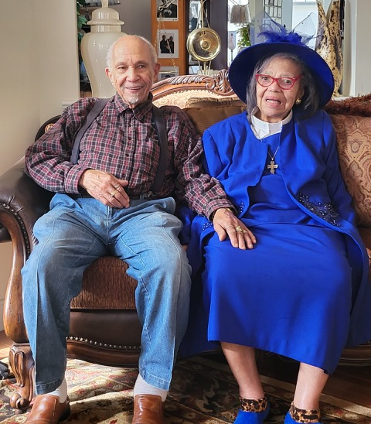
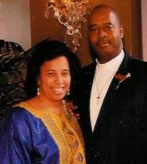
Church History
Abridged from the 150th Anniversary Souvenir Journal
1985, Rev. Dr. Janet Harmon was assigned as Pastor of Mt. Joy served until 1992. Under her leadership, she conducted a study of needs of the South Wilmington community in conjunction with the Neighborhood House. The study identified a lack of programs for youth, single parents, and seniors. As a result of the study, Mt. Joy started a “Church and Community Worker Program”. The program was the first of its kind in the Peninsula-Delaware Conference. It offered senior, youth, and single parent programs, and a substance abuse program. The senior program started in 1987 and continues today.
1997, Rev. Derrick Porter was appointed pastor Mt. Joy Church. Under Rev. Porter's leadership, the church established and defined its mission to Worship (Psalm 100), Witness (Matthew 25:31) and Win (Matthew 28:18-20). He challenged the members of the congregation to revitalize and expand its outreach ministries. The Breakfast Ministry consistently fed 80-100 people each week. Homeless men, women, and children as well as the community members were warmly welcomed and served a hearty hot breakfast. They were also invited to join the “Come as you are” services.” "Come as you are“ services opened our worship services to those who may not have felt comfortable to sit in a "traditional“ church setting. Many people joined the church because of the Breakfast ministry and the come as you are mentality. Rev. Porter recognized the large number of teenagers in the congregation and started a program called the "Hook-Up" in which the teens would gather in his office and have open and honest conversations about the issues they faced and how to relate it to the bible. The young adult choir was revamped and changed its name to “Voices of Praise” stating that “we weren’t that young anymore.” Rev. Porter felt it necessary to connect with the youth in the community in an environment outside of church. He encouraged the development of our Youth Outreach Ministry and secured funding from the Conference to engage the youth in the Southbridge Community.
The community was invited to Thanksgiving dinner which was always filled. One of the most promising endeavors was to allow Urban Promise to utilize our facilities for its afterschool and summer camp programs which are still a blessing to the children in our community. Rev. Porter envisioned building a new facility to service the community. During his tenure, the Planning and Building

Slide 20
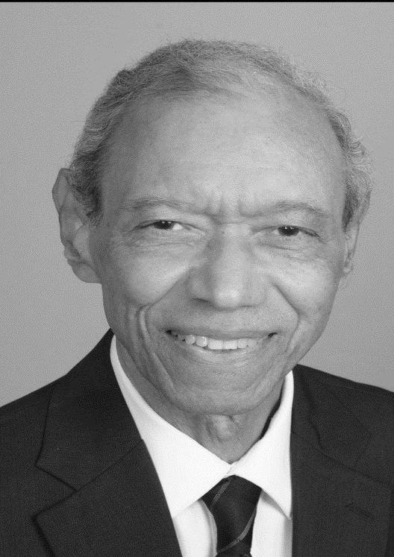
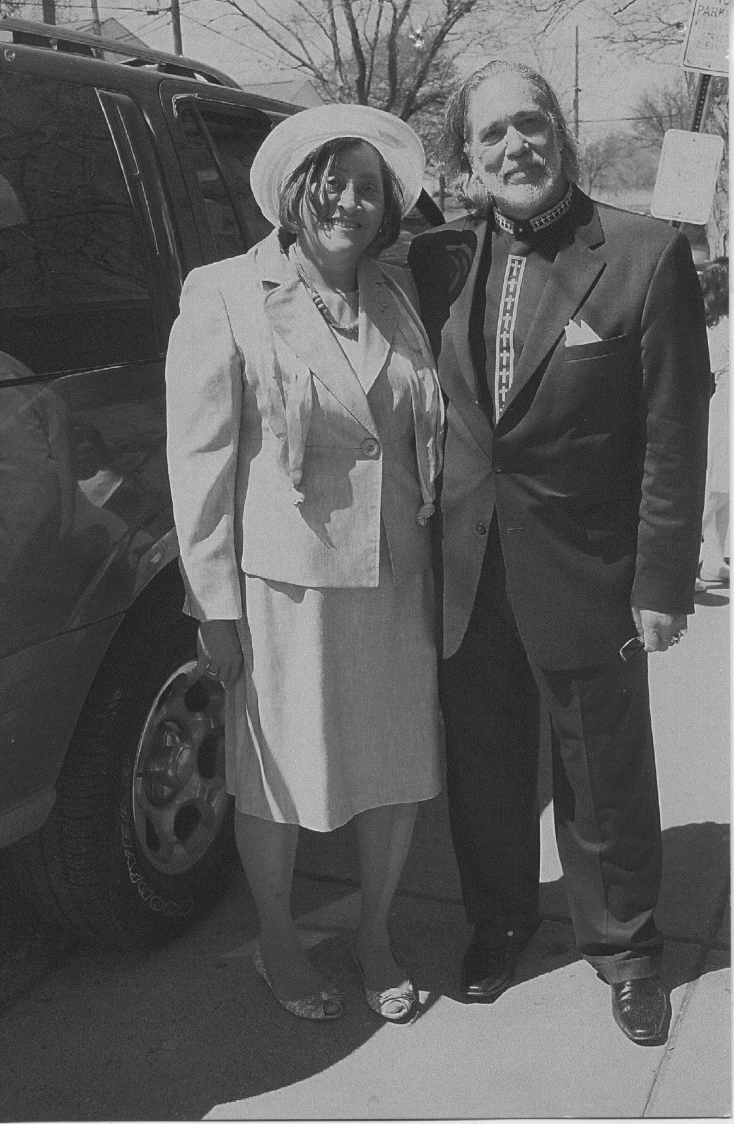
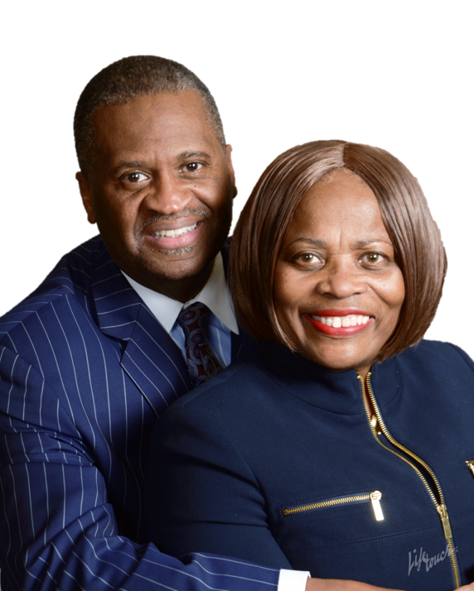
Church History
Abridged from the 150th Anniversary Souvenir Journal
Committee was birthed, and the congregation committed to investigating the possibility of building a new facility by offering a good-faith down payment on Mr. White’s property (this effort was led by Karen Anderson-Bowen - our resident architect) and the late Wayne Brown.
Rev. Porter also started the precursor to the Media Ministry through recording the services and making CDs and DVDs available to those who could not attend service. His exemplary leadership was recognized, and he was appointed District Superintendent in the Pen-Del Conference. Rev. Porter often says Mt. Joy is a church filled with love and it will always be home to him.
2010 Rev. Dr. James T. Seymour served as interim pastor until 2011 to maintain the stability of the church.
2011 Rev. H. Ward Greer stepped into the role as Sr. Pastor until 2014. Rev. Greer was instrumental in revitalizing the Sunday School Program and Flame Throwers which was a youth outreach initiative.
2014 Rev. Dr. James T. Seymour stepped in again being led by holy spirit and inspired by the music of the “Voices of Praise” choir, stating “he couldn’t get to church fast enough to hear such a powerful choir.” He worked diligently with Mt. Joy leadership to get our affairs for the newly appointed pastor.
2015 Rev. Provey Powell, Jr. was appointed and hit the ground running. He met with the leadership of the church July1 the first day of his assignment to establish a covenant relationship. His divine purpose is to bring out the greatness in all whom he encounters He has been intentional about expanding and creating opportunities for leadership, resulting in the Mt. Joy’s first four Certified Lay Ministers and one Licensed Local Pastor. Through the generous grants from the Wilmington Urban Center Ministries, Rev. Powell strengthened the ACT (Audio Communication and Technology) initiative, Children's Outreach Ministries and Children’s Church. He also made room for Youth Take Over Sundays where the children and youth are responsible for the Worship Experience.
After some brainstorming about how to reach the missing generation (in the church) New Wine Mission (Millennial ministry) was developed. The purpose was for Gen Y & Z to develop their own style of worship outside of the walls of the church while being able to offer personal support some personal needs.

Slide 21
Church History
Abridged from the 150th Anniversary Souvenir Journal
Financial Literacy was also offered to children through Jr. Achievement and Adults through a few different partnerships.
Rev. Powell, being a member of the Board of Education, was instrumental in partnering with the Southbridge Neighborhood House to create learning pods during the pandemic to serve families who were not able to be at home with their children. This opened the door to 1 on 1 tutoring in the Christina School District which increased reading and Math proficiency. During the pandemic only being allowed 10 in the church, Rev. Powell became very forward thinking about getting the word out to the masses. Because we had already advanced in our technology, he took that opportunity to fully utilize his Lay Ministers, ACT team and a few Choir Members to create a virtual
Worship experience every week for almost 3 years. We were able to continue weekly bible study online and even join with as many as 3 other churches virtually. He also created a space in our backyard to ‘Pull up and Praise”. The outdoor worship experience was birthed so that spiritual inspiration would be shared throughout the local community. He is always looking for opportunities to expand and birth ministry. He continues to remind us that we have to have Faith. It doesn’t matter what it looks like “Faith is the substance of things hoped for the evidence of things not seen”.
Rev. Powell’s love for youth and children was the motivation for his appointment to the Delaware State Board of Education as he works with community leaders though the Southbridge Civic Association for the betterment of Southbridge and surrounding communities. From the financial support of the United Methodist Congregational Development Corporation and the Mid Atlantic Foundation, Rev. Powell was able to visualize and implement the Mt. Joy’s newly established Eden Project, which is designed to generate multiple streams of income. The streams include traditional Tithes and offering, our newly reinstated Jubilee Development Corporation, a 501c3 organization, Endowment Fund, and a For-Profit Enterprise for youth. During his tenure, the building team was re-energized by God’s spirit, to purchase and acquire local property, resulting in the development of our current vision of “A Bridge to Wholeness Campus “. Pastor Powell (lovingly referred to as the hardest working part-time pastor) and Lady Joyce continue to serve with joy and enthusiasm.

Slide 22
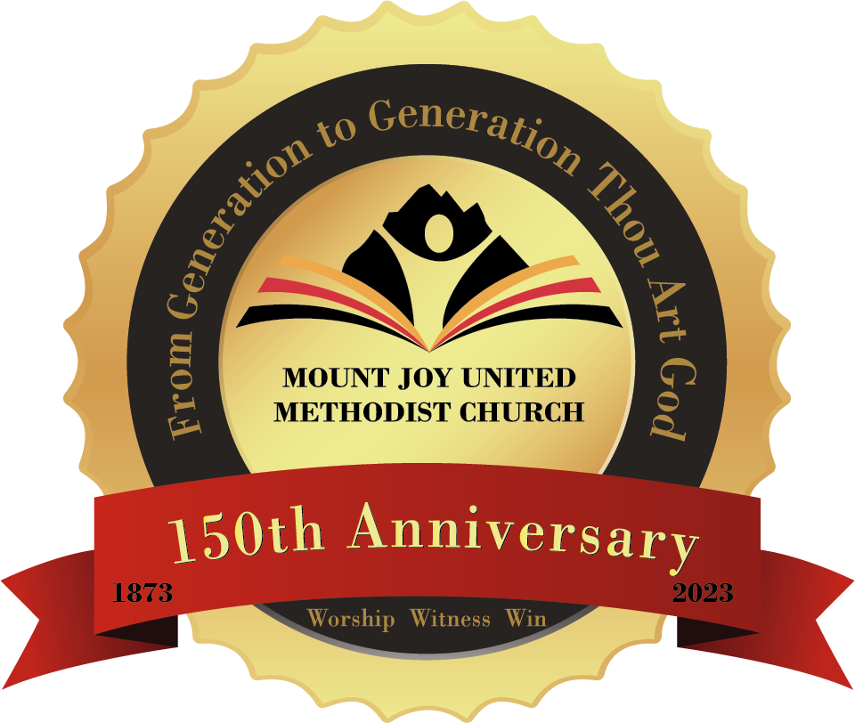
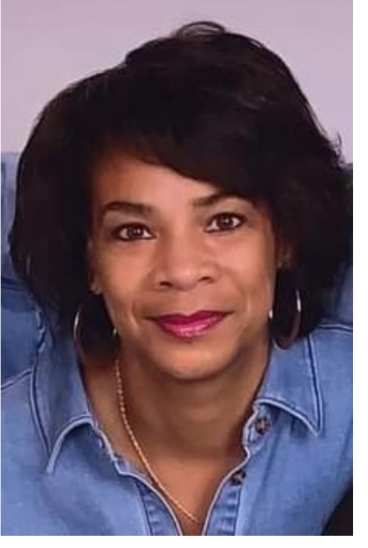
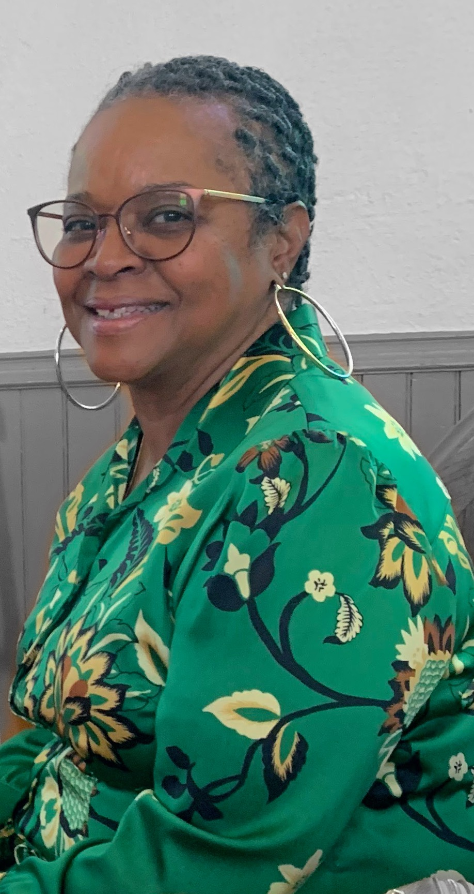
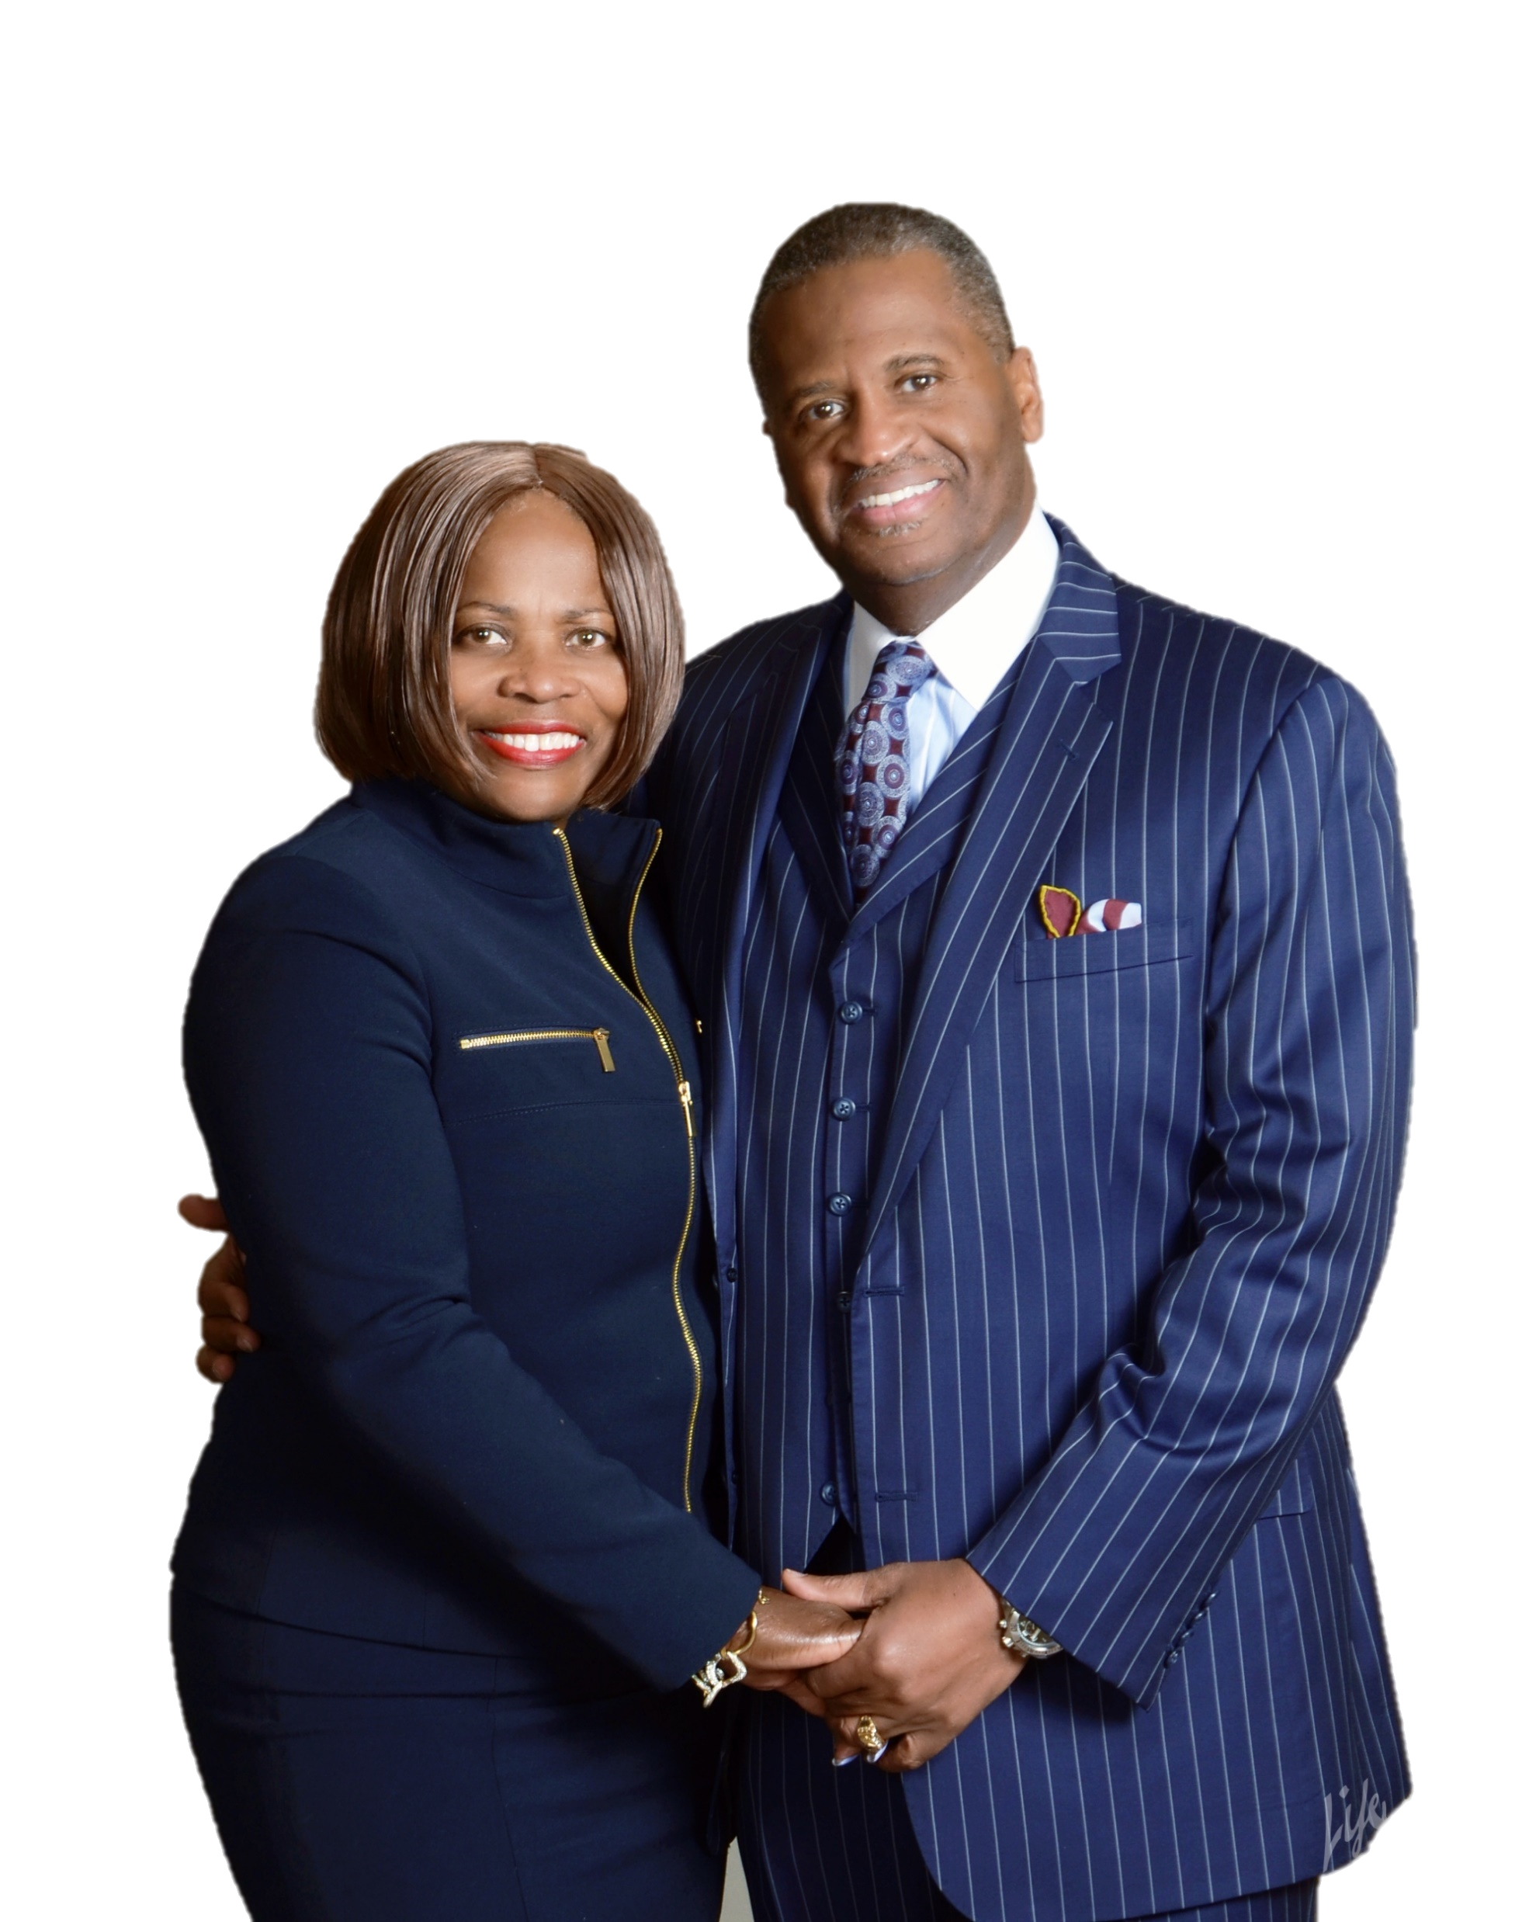
150th Anniversary Committee
We thank you for worshipping with us on this historic occasion
Laretta Wilson
Chairperson
Cynthia Righter
Vice Chairperson
Lorri Agnew-Smith Betty Anderson Raymond Brown Crystal Brown Dwight Cephas Dianne Cannon Shelly Chase MaryAnn Davis Beverly Evans Victor Norris Joyce Powell Dee Randolph Skinner Loraine P. Watson Marlene Wright Sharon Young Rev. Provey Powell, Jr.
Lady Joyce and Pastor Powell
Church Information
Contact (302) 655-7751 – Office
Email mtjoyumc@gmail.com
Facebook mountjoyumc
YouTube mtjoy e church
Designed & Layout – Loraine P. Watson
Edited by Lorri Agnew-Smith
Photos by Crystal Brown

Slide 23
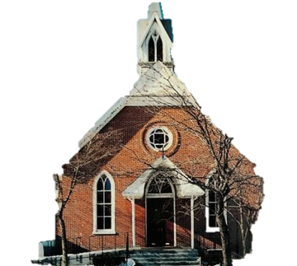
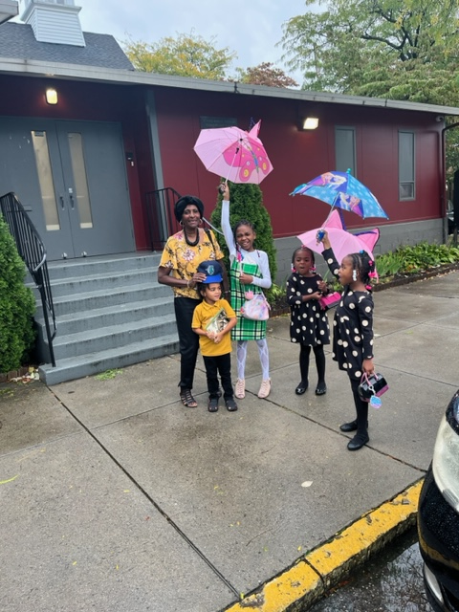
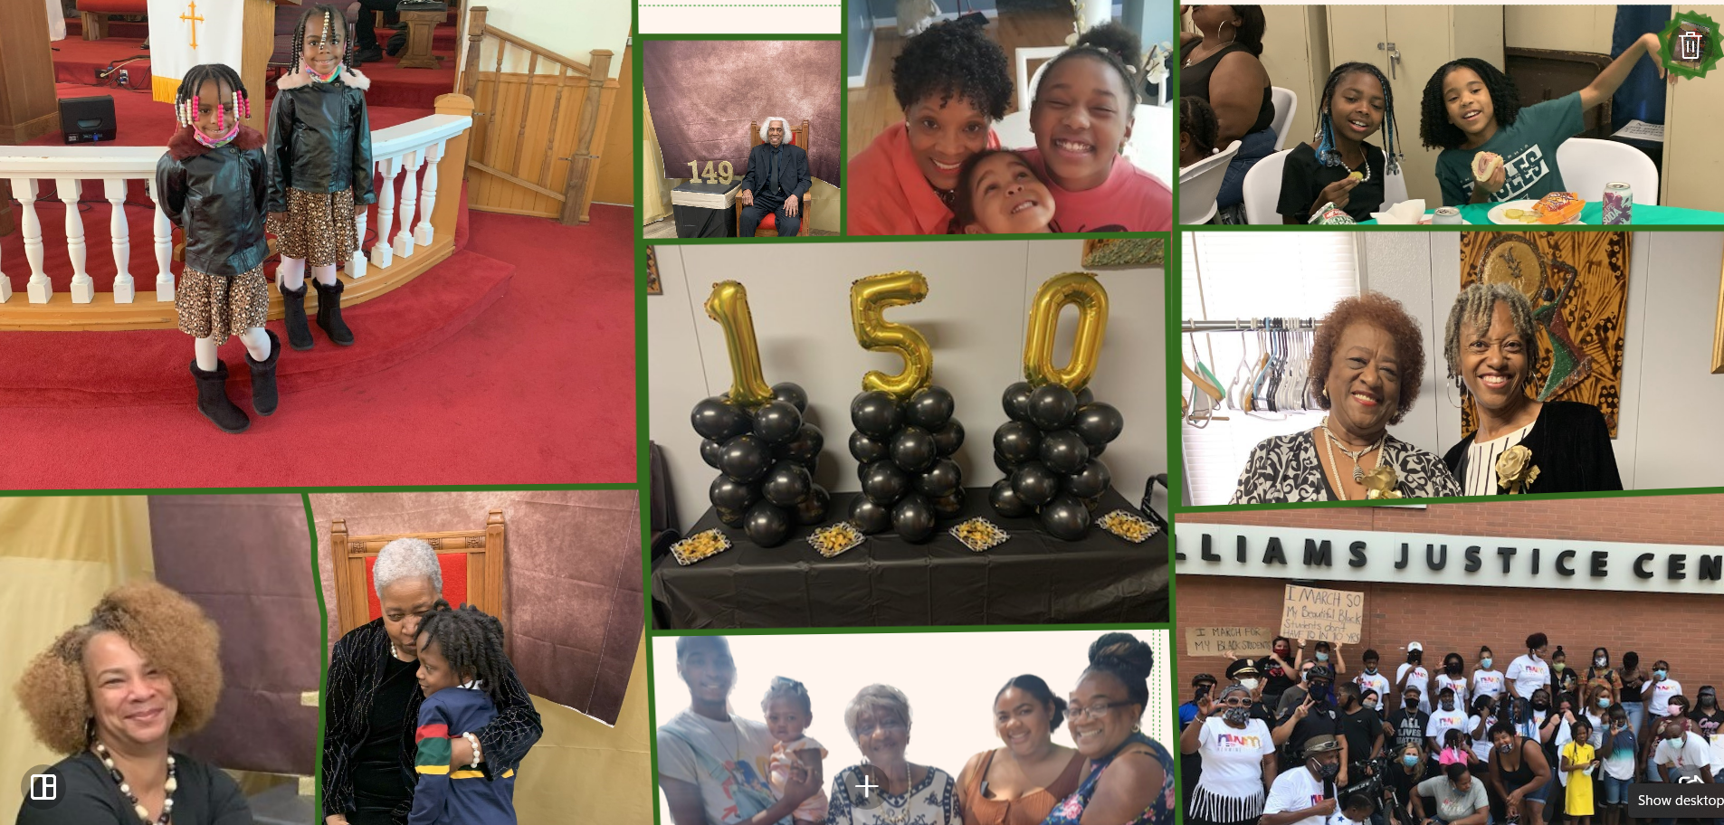
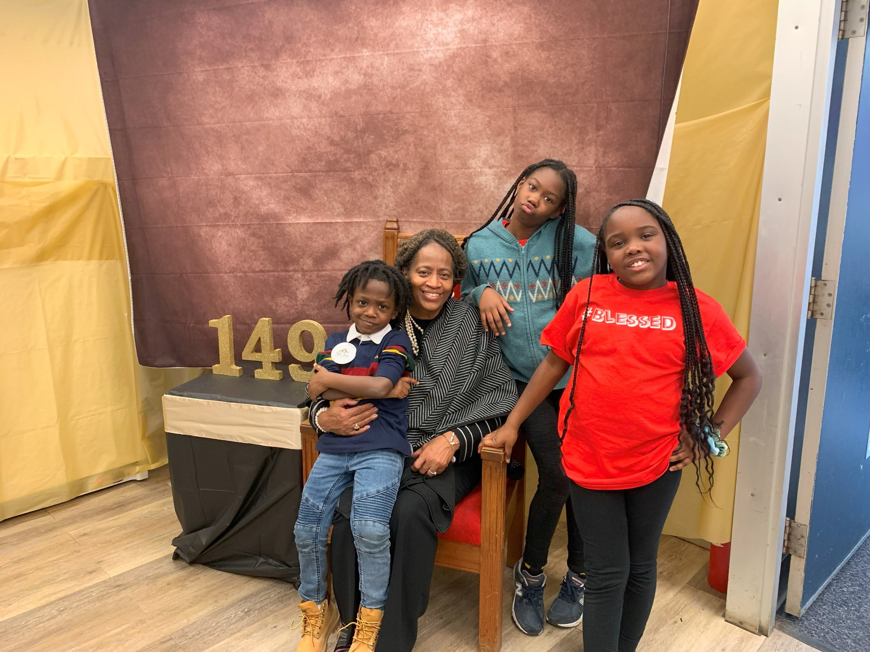
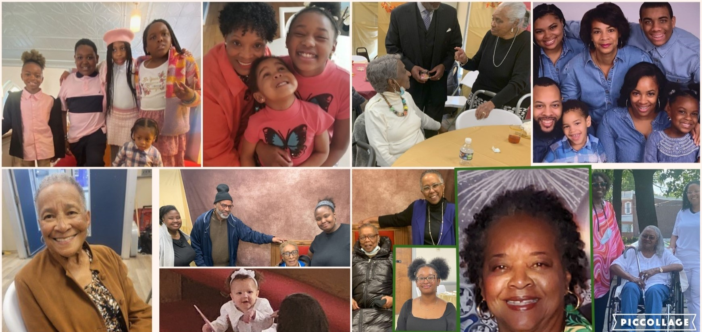

From Generation To Generation
Thank You!
Thou Art GOD
Psalm 90:1

